Slide 1

2026
Valparaiso, Indiana / September 21, 2026
Paper, Please? We Can Do Better!
What if managing diplomas, transcripts, and academic records could be simpler—for staff and students alike? Join us as we move beyond paper and explore how Valparaiso University has partnered with Parchment to streamline credential workflows, reduce manual work, and create a better experience from diploma delivery to transcript requests.
We’ll start with a quick look at Parchment, share real-world examples of how easy it can be to implement and manage digital credentials, and wrap up with a look at new Parchment products and what’s next for higher education credentialing.

Slide 2


2026
Valparaiso, Indiana / September 21, 2026
Welcome!
Rhonda Crowley
Transfer Credit Coordinator
Baker
I have a soft spot for anything pink and flamingo themed!
Shalon Anderson
Parchment Account Executive
Sports Mom
Farming Family

Slide 3

2026
Valparaiso, Indiana / September 21, 2026
Parchment Solutions In Use at Germanna Community College
A Variety of Tools
to Support Diverse Needs
Transcript Services
Receive Premium
Diploma Services
Raptor Data Automation
CLR Services
Gateway
Verification Services
Transfer Articulation
Equate Transfer Articulation
Transfer Articulation
Certificate Services
Course Sharing
Recruit
Course Sharing
Digital Badge Services
Dual Enrollment
Dual Enrollment
Dual Enrollment
Notes:
Most institutions don’t wake up thinking, ‘We need another technology platform.’
They’re trying to solve very practical problems: too much manual work, too many student questions, too many disconnected processes, and not enough staff time.

Slide 4

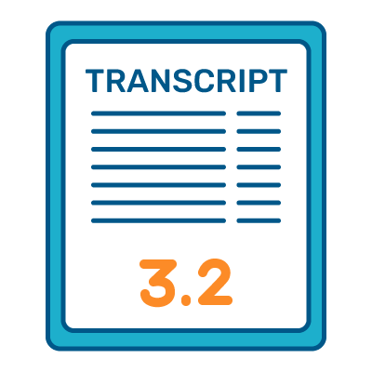

2026
Valparaiso, Indiana / September 21, 2026
Parchment Solutions In Use at Germanna Community College
A Focus on Operational Efficiency
Extract key data or coursework from student transcripts– instead of manually typing or searching for data points
Raptor Data Automation
Allow students to upload their own transcript to immediately receive progress feedback and a quick, unofficial transfer evaluation
Gateway
Print + Digital together, Built-in address check to reduce returned diplomas, and Replacement diplomas becomes self-service
Diploma Services
Notes:
Parchment’s platform offers tools help to DRIVE operational efficiency.

Slide 5
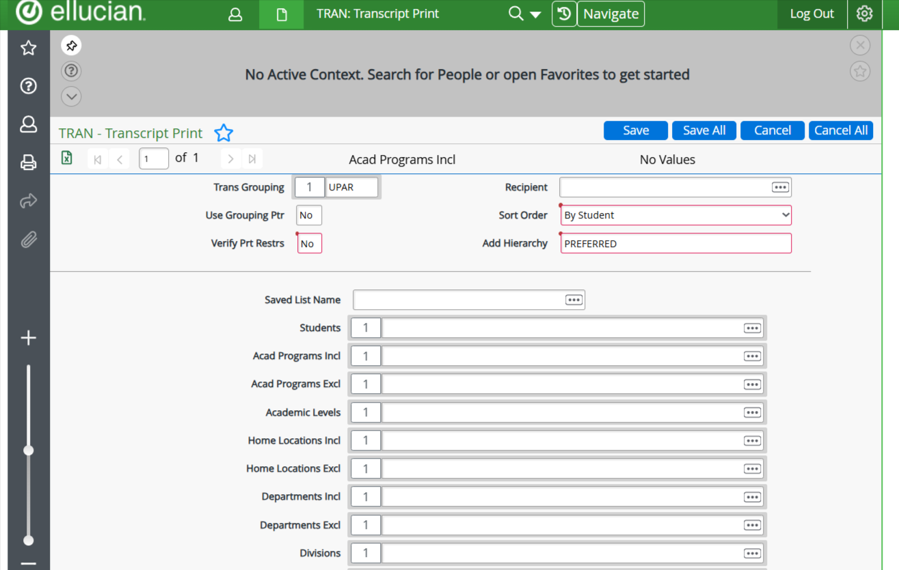
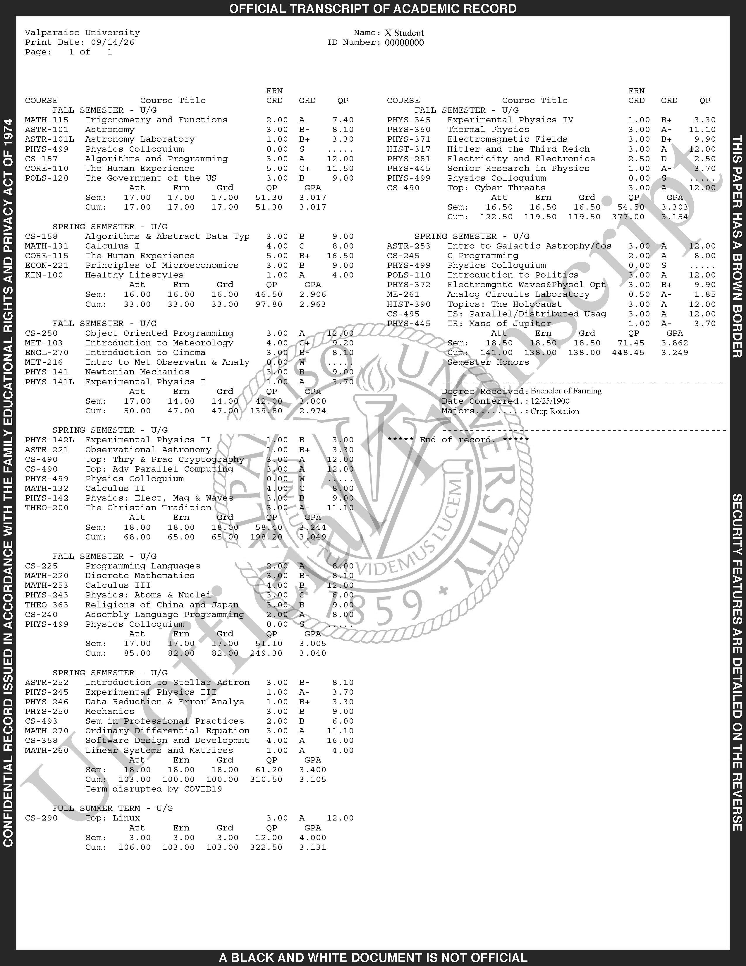
Transcripts – The Early Days
Retrieve orders in Colleague
  RQSS - Request Summary
STRQ - Student Requests Print
Load Savedlist (XSAV) in TRAN
Print in House to a designated printer
Fold, stuff, address, and stamp (3 stamps) each envelope

Slide 6
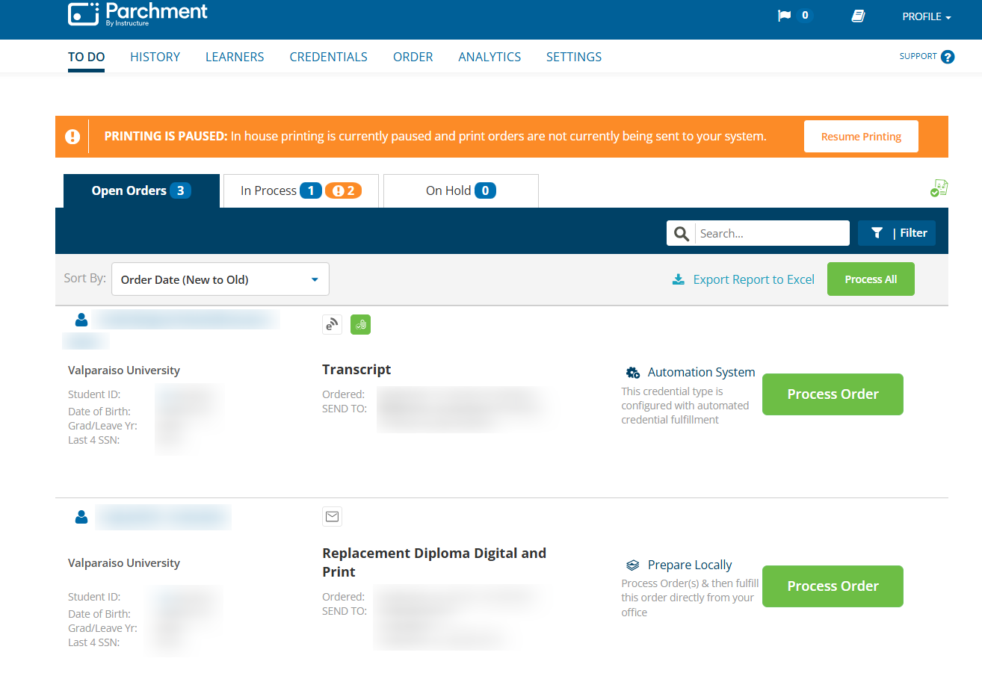
2026
Valparaiso, Indiana / September 21, 2026
2013 and beyond……

Slide 7

Diplomas - Prior to 2023
Receive daily spreadsheet of recently placed orders
Communicate with the Finance Office for payments
  Duplicates or International shipping
Print in House using the templates created in DOD, diploma cardstock, and a designated printer
Students picked up diplomas from our office or we shipped them

Slide 8
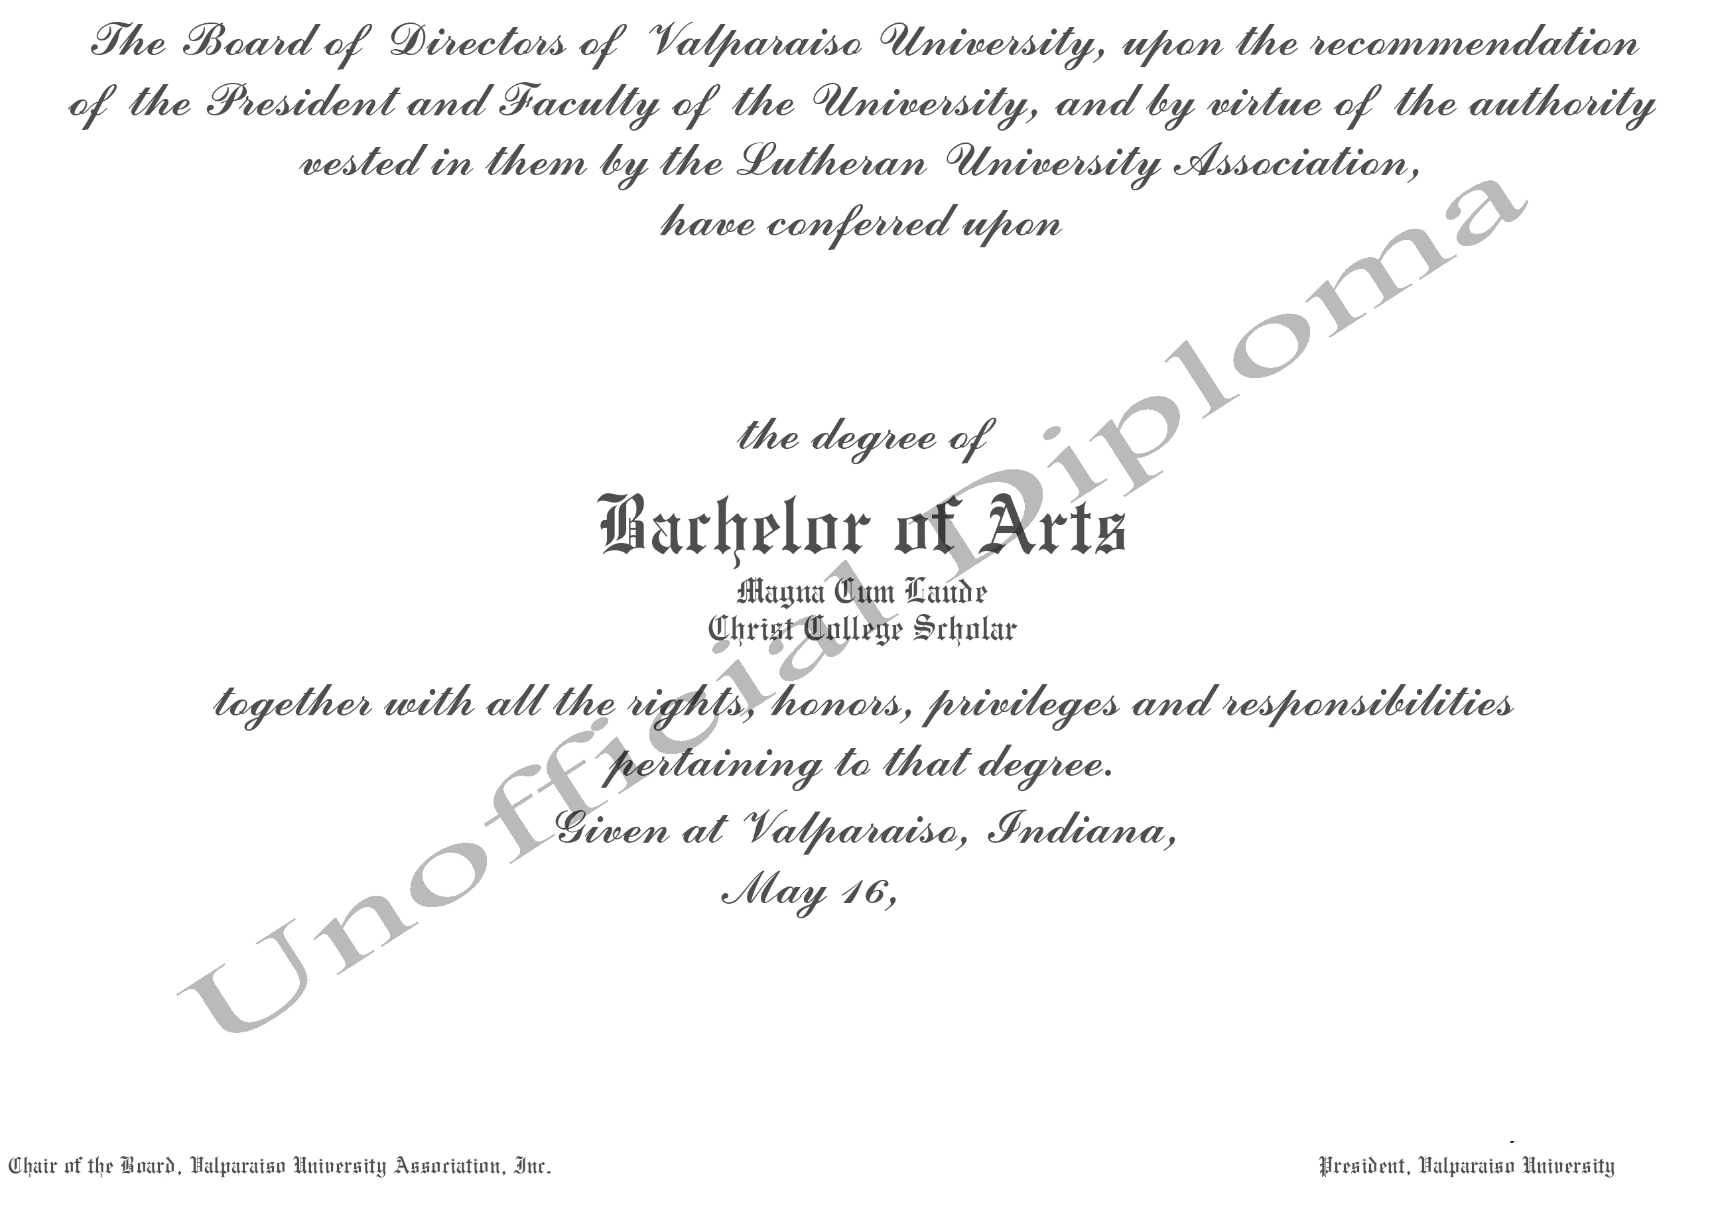
2026
Valparaiso, Indiana / September 21, 2026

Slide 9
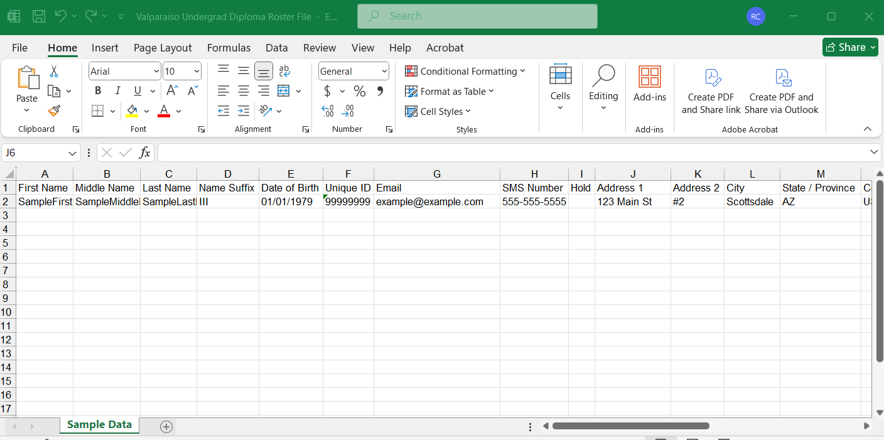
Parchment Rosters

Slide 10
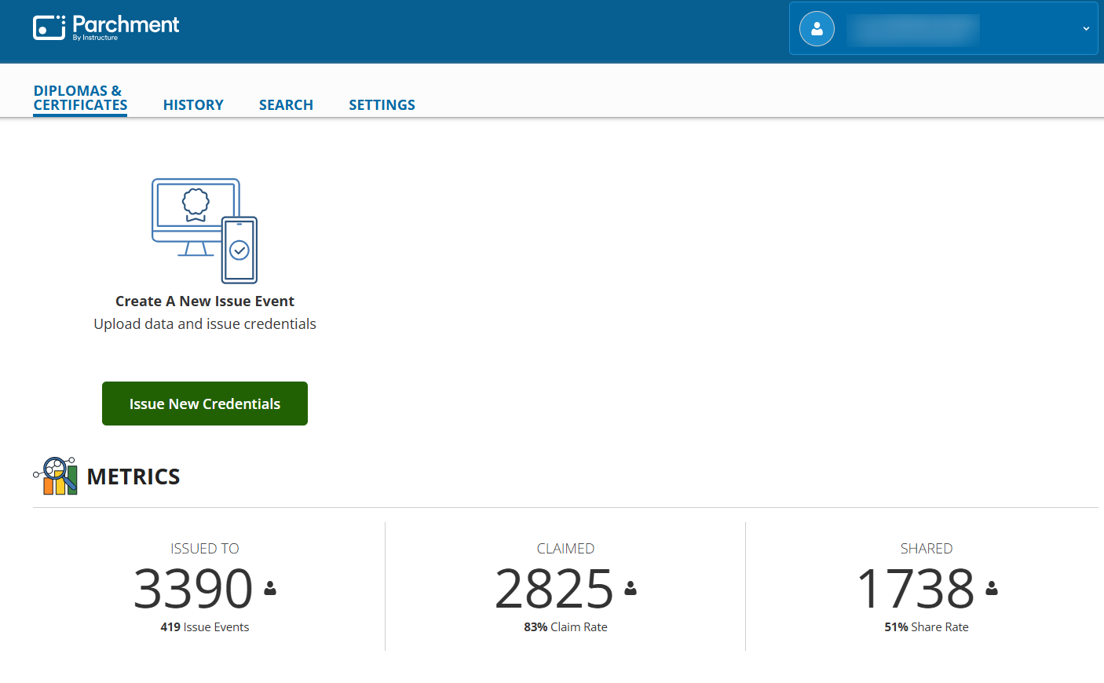

Slide 11
PROS
No longer have to keep materials stocked
No longer deal with payments
No longer deal with shipping
No longer deal with reprints (damaged or lost during shipment)
No longer printing in house
Rare to see a student pick up their diploma
CONS
We cannot print a diploma in house
Once a roster is loaded, cannot change the country the diploma is being shipped to

Slide 12
2026
Valparaiso, Indiana / September 21, 2026
Discussion
Is there a workflow or process in your office that requires more manual labor (or back and forth) than it probably should?
What is something (big or small) that your office has recently changed that (now) makes you think, “We should’ve done that a long time ago.”
What is the biggest barrier to process improvement?

Slide 13
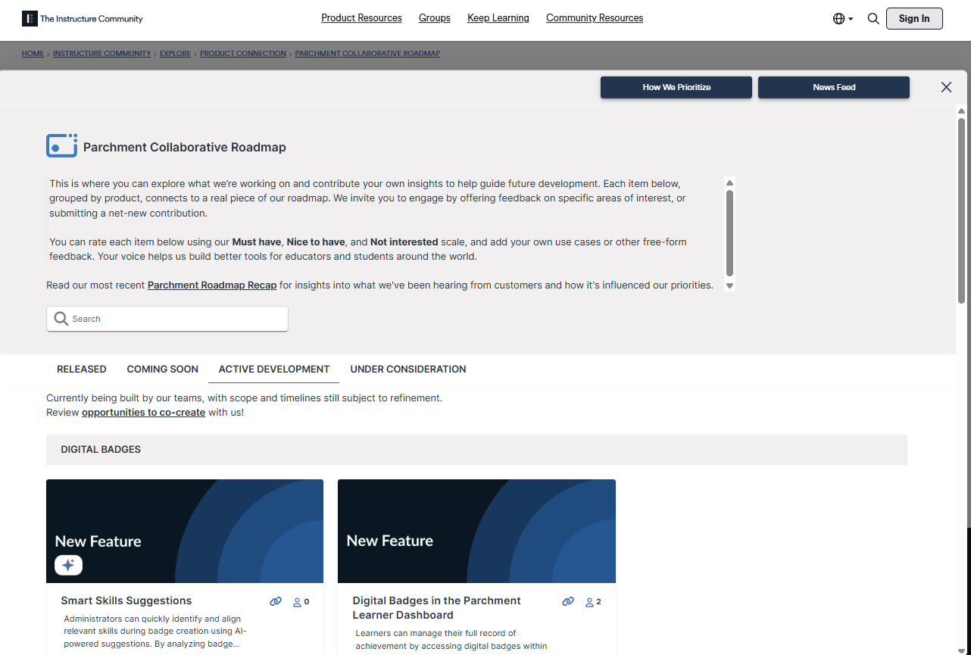
2026
Valparaiso, Indiana / September 21, 2026
Parchment Collaborative Roadmap
https://community.instructure.com/en/categories/parchment-collaborative-roadmap
Notes:
https://community.instructure.com/en/categories/parchment-collaborative-roadmap

Slide 14
2026
Valparaiso, Indiana / September 21, 2026
What’s New & Next from Parchment?
Raptor Data Automation (available now!)
  Boost efficiency with AI-powered transcript data extraction
Gateway Data Automation (available now!)
  Give feedback and gather hot leads with immediate (pre-application) transfer credit evaluation
Comprehensive Dual Enrollment Platform (2027 launch)
  Simplify and streamline enrollment and program management workflows
Transcript Request Identify Verification (Q4 2026)
  Fraud Prevention - Stop bad actors trying to create fake accounts using a new optional ID/biometric-enhanced credential ordering workflow
Everyone is welcome to join Parchment Community’s Free Annual Virtual Event - https://www.instructure.com/events/parchment-summit
October 22, 2026 11:00am ET - 5:00pm ET
Notes:
Learn more from Parchment Community’s Free Annual Event - https://www.instructure.com/events/parchment-summit October 22, 2026 11:00am ET - 5:00pm ET
Come together as one Parchment community, then make the day your own. Choose from dedicated Higher Education or K–12 sessions—or move between sessions based on what matters most to you.

Slide 15
2026
Valparaiso, Indiana / September 21, 2026
Thank you!

Slide 16

2026
Valparaiso, Indiana / September 21, 2026
Questions?
Comments?

Slide 17


Photo credit
The photo used to create the template for GLUG was downloaded from unsplash.com.
Photo by Nicolai Durbaum (33772) on Unsplash.
https://unsplash.com/photos/Xeh-NHvw_-4

