Slide 1
Delivering the Intelligence you need to achieve success
Paul Bocci | Account Executive | Evisions

Slide 2

Argos in Colleague and Banner
725+ Colleague and Banner Institutions currently leveraging Argos
85% of SaaS schools use Argos
Shared success across all Argos institutions
Notes:
45 of the 48 SUNY Banner Institutions currently leveraging Argos in addition to many Banner SaaS Institutions and SICAS.
Starter Pack, Co-Op and story of sharing DataBlocks between schools. President leaves for another institution, takes the datablock of daily enrollment report with him to new institution.
Shared Success Across All SUNY SaaS Insitutions
Shared DataBlocks
Shared report library
Shared best practices
Less duplicated work
Faster deployment across campuses
This came up several times as a major value point.
85% of SaaS schools use Argos
SUNY Orange -> SaaS writing on the wall
South Orange CCD -> boomerang, fastest Argos, insights struggle
ACCS
PASSHE
CSCU

Slide 3
The Power of Argos
Ease of Use for End Users
No More Garbage in, Garbage Out
Your Sole Source of Truth
Automation Business Processes & Student Comms
Notes:
Start with DataBlock Definition…. 2 things I want you to remember if nothing else…. Ratio with Reports/Dashboards and Ratio with Data Sources
There are 4 huge advantages you can leverage to achieve your goals, no other reporting solution can provide all 4.
Ease of Use for End Users
No SQL Needed to create, schedule or modify reports***.
Dashboards that empower your users to interact with their data on a daily basis to answer questions on the fly.
Easily see how fast subjects, courses sections are filling up (or not) to make important decisions on the fly to achieve Course Optimization.
“If the data is going to be in your end users hands, it better be easy or else they will likely not adopt it and continue to rely on Technical Resources.”
Your Sole Source of Truth
Our Data Dictionary provides a Sole Source of Truth for your data no matter where it is coming from. Custom Definitions, Preferred Banner Joins, Table Properties and Field Aliases flatten the learning curve across campus, providing Peace of Mind & Confidence in your reports and data.”
Data Dictionary
Has anyone heard of spritele, pasta, actually the phone number field
Banner has 20k table over 6k student table,
What are you going to do? You're going to have to join them with SQL, we already have that
This is where you can mention the pass through of vetted data to Tableau or Power BI so they have uniformity and Data Integrity Issues won’t bubble up, we have seen time and again this lead to Data Governance Committee’s spending so much time, spinning wheels getting folks to agree on what a 1st time full time student is and all the while if they had Argos, much of this could be avoided”
No More Garbage in, Garbage Out
Argos is a full SQL Tool that can insert and update databases. It is especially great with missing data dashboards or discrepancy reports but can take it a step further and allow you to correct the data in the database itself to clean up the garbage. Swarthmore College created a Data Health Check Dashboard for this and their data is pristine as each data steward can easily see any garbage and fix it all without leaving the Argos Dashboard.
Automating Business Processes
“Other tools show you the list. Argos can execute the next step, securely and governed.” It can perform Workflow processes based on your custom Logic, if the data says this, do this, if the data says that, do that.
Ex. (Adjunct Faculty contract creation and approval workflow, Faculty Load Alerts as they approach a certain amount or % of credit hours.
Student Facing Communications
Argos can become your proactive engine, not just deliver passive reports. It can burst emails to students based on logic, Withdrawals, Absences, GPA, Missing Requirements.
Admissions Letters: Centennial College replaced 140 Admissions letter variants with 5 governed logic-driven templates that pull the correct data to send the correct letter to each student. Set the logic once; let data drive personalization and routing
FAFSA Acceleration: Lansing CC’s FAFSA process had prospective students up to 200 days overdue on completing all the steps in their FAFSA. They built a Missing Info Letter once and it dynamically will send out to each student the list of specific steps they needed to complete each week. Helped the students through the process and got the highest overdue down to 7 days after a couple months. This DataBlock has been downloaded over 400x from our Co-Op.
It also will update Banner that the email was sent so they have a record and a copy of everything.

Slide 4
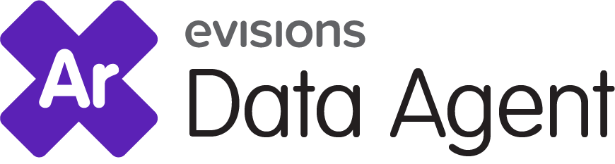

Uncover patterns and trends you couldn't find before
Work from the DataBlocks you know and trust
Understand exactly how answers generated
Maintain full control over data and AI usage
Notes:
Card 1
Surface changes, anomalies and patterns in your data that would otherwise go unnoticed
Card 2
Every answer is grounded in trusted, institution-approved DataBlocks
Card 3
See the SQL, logic and data sources behind every answer for full transparency
Card 4
Maintain full control with MAPS permissions and Zero Data Retention

Slide 5
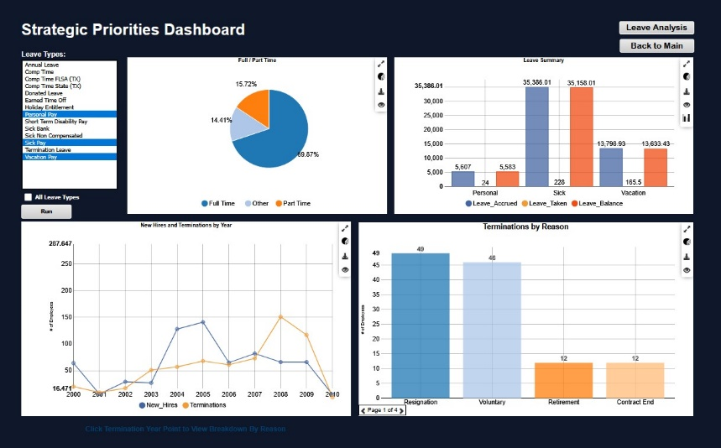
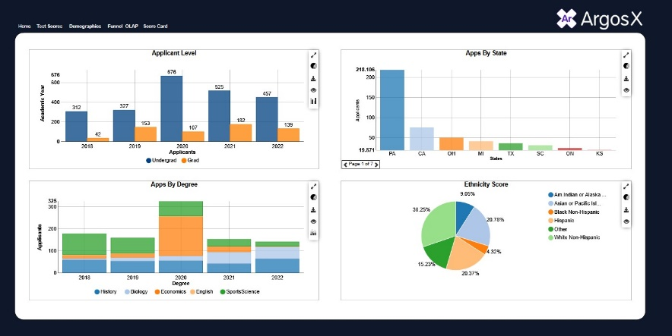
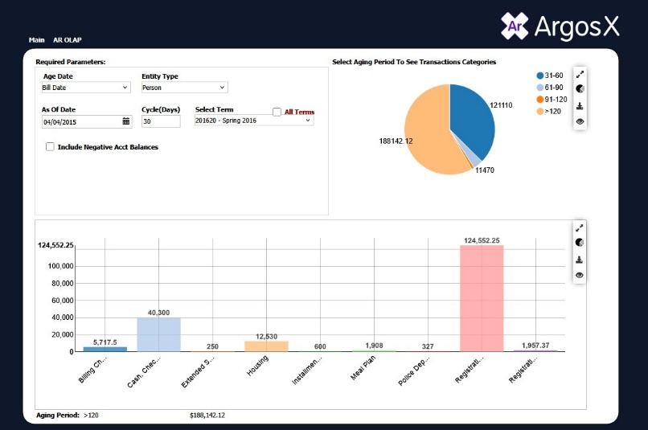
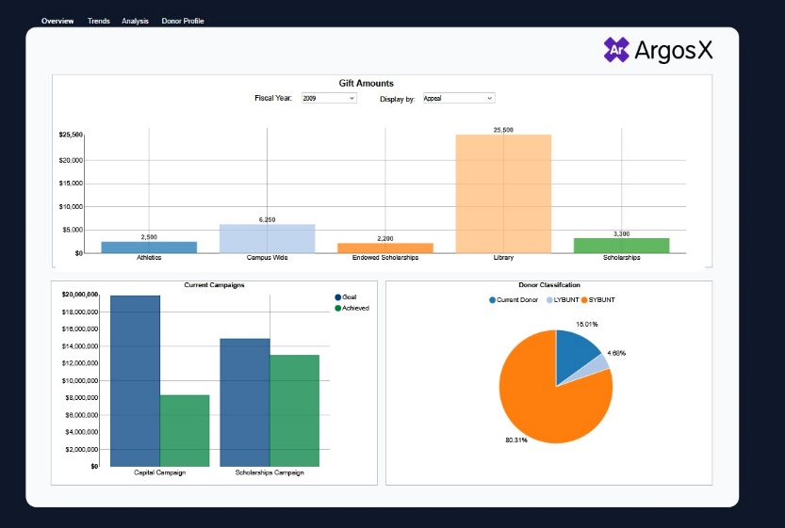
Let’s dive into Argos

Slide 6
Resources at your fingertips!
Co-Op & Community
Customer Success Team
Argos X Academy
Argos User Groups
Notes:
Getting started with a new solution is just the beginning or if you have owned it for years, we want to make sure everyone has the resources, connections, and support they need to continue learning and getting more value from Argos over time.
So I want to take a few minutes and show you some of the resources we’ve built around Argos X to help you do exactly that.
Let's start with the Co-Op and Community...

Slide 7
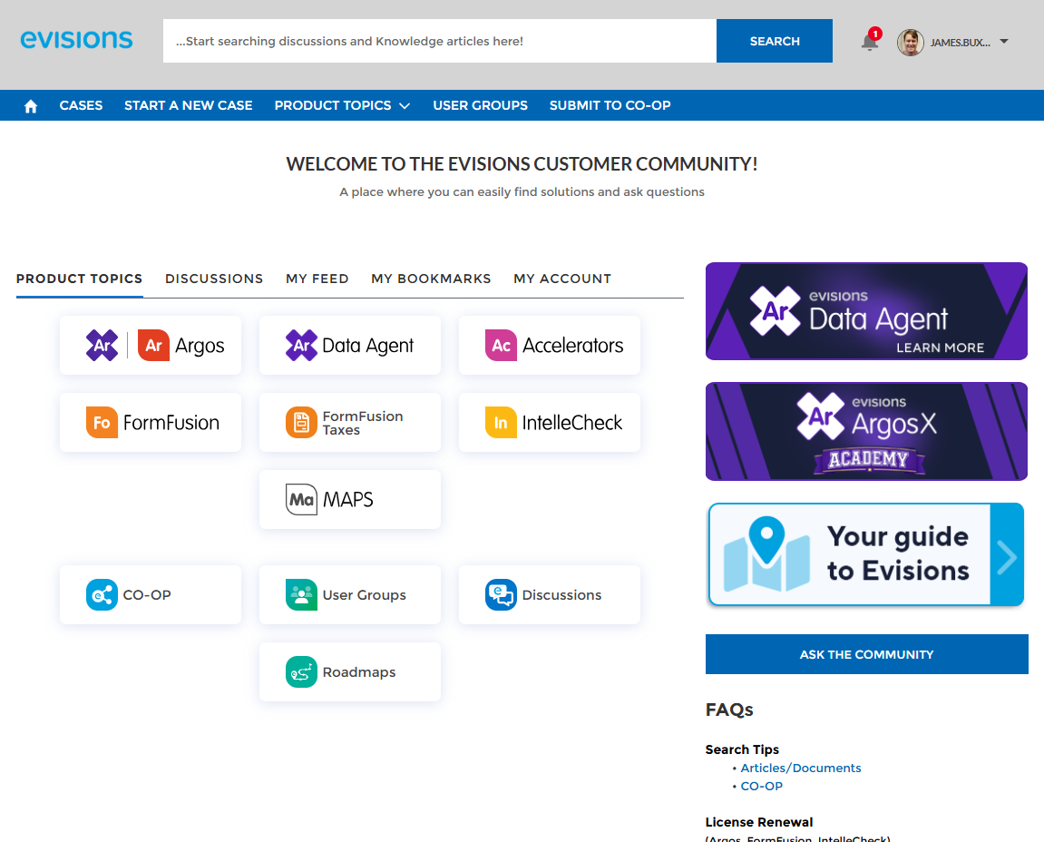
Co-Op and Community
Notes:
One of the advantages of joining the Evisions community is that you’re not just learning from Evisions. You’re joining a large group of higher education institutions that are solving many of the same reporting challenges you are.
Through our Community and Co-Op resources, customers can learn from one another, share solutions, and often find that someone else has already tackled a problem very similar to theirs. This is also a powerful resource for you to communicate with Support, as well as find important production documentation like product roadmaps, release notes, and also join the online version of our User Groups, which will discuss here in a few minutes.
That peer-to-peer knowledge is especially valuable for Colleague institutions because there is already a strong community of customers working with the same types of data and business processes.
Current customers: if you need access to the Co-Op, just let me know!

Slide 8
Customer Success Team
CONNECT
Connect you with the right people and resources across Evisions, bringing together Product, Support, Professional Services, and others when needed.
ADVOCATE
Serve as your voice within Evisions—sharing enhancement requests, feedback, and ideas directly with our Product and Development teams. We also connect customers with beta opportunities to help validate future improvements.
GROW
Help your team get more from the tools you already own—from adoption strategies and product deep dives to refresher sessions for new staff and guidance on capabilities you may not be using today.
Decades of Higher Ed Experience | Work Across Your Organization | Included at $0 Additional Cost
Notes:
Our Customer Success Team is really here to be your partner beyond implementation. We have decades of combined Higher Ed experience, and we can work with anyone across your organization to help you get more value from the Evisions tools you already own.
Sometimes that's simply connecting you to the right resource. Other times, we're bringing together Product, Support, Professional Services, or other teams within Evisions to help you move something forward.
We've also become an important sounding board for our customers. We take your enhancement requests, ideas, and feedback back to our Product and Development teams and advocate on your behalf. We also organize beta opportunities that allow customers to directly help us validate new features and improvements.
And we know staff turnover is a very real challenge in Higher Ed. We've conducted many product deep dives and refresher sessions to help new team members get up to speed, understand the different modules available to them, and even go deeper when they need help getting something set up.
Ultimately, our goal is pretty simple: we want you to become even better with our tools.
And one of the best parts? There's no additional cost to work with us.

Slide 9
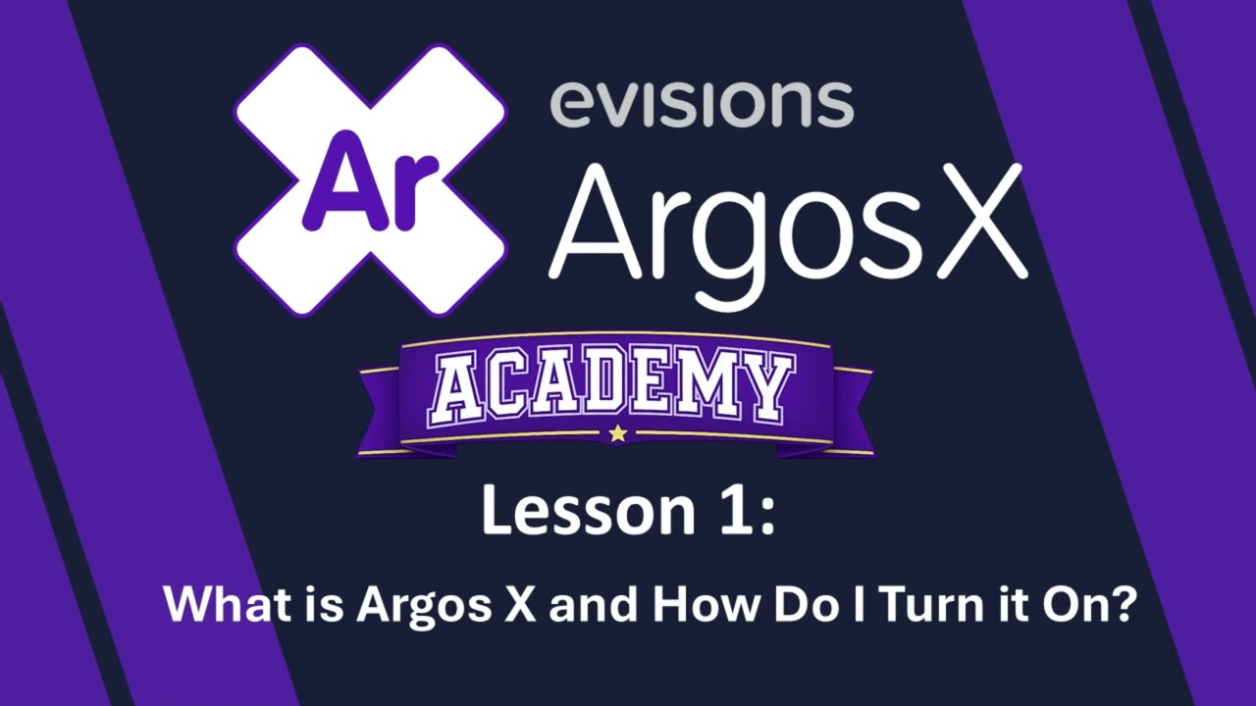
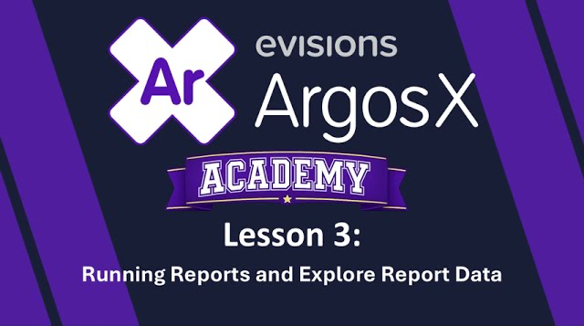
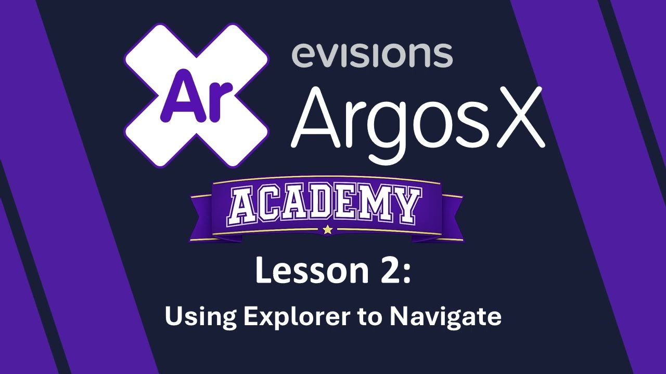
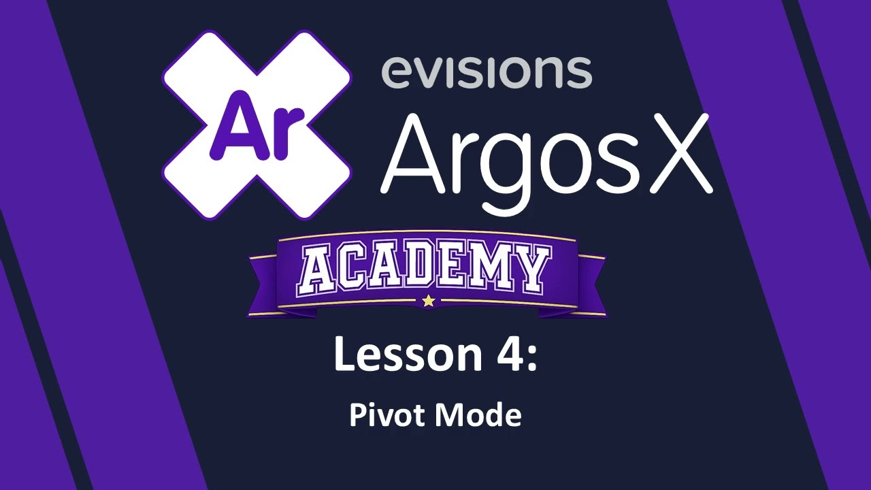
ArgosX Academy
Notes:
…Kick to Bill to Set the Stage…
Why do we need Argos if we're moving to Banner SaaS?
Operational reporting beyond Insights
Enterprise reporting across departments
AI-powered analysis
Dashboards, communications, and automation
Reporting across multiple data sources
Why should we implement now instead of later?
Reporting needs begin on Day 1
Implement alongside Banner SaaS
Validate data during migration
Reduce go-live risk
Shared implementation across SUNY institutions

Slide 10
Argos User Groups
  Quarterly Zoom meetings of Argos Users with the goal to:
    Engage and Collaborate with other Argos users in the community
    Help users network and share ideas, resources, and impactful best practices
    Learn from each other and from Evisions team members
  Each meeting includes:
    Evisions and Client-led presentation (demo and/or live DataBlock)
    Roundtable discussion
  Currently have 3 Active User Groups
Notes:
Open to any Evisions customer and prospects! We started these user groups in 2023 and these have become a vital resource for customers everywhere.
Quarterly Zoom meetings of Argos Users with the goal to:
Engage and Collaborate with other Argos users in the community
Help YOU network and share ideas, resources, and impactful best practices
Learn from each other and from Evisions team members
Each meeting includes:
CO-OP review with Professional Services tips and tricks
Client-led presentation (demo and/or live DataBlock)
Roundtable discussion
Currently we have 3 active user groups, so allow me to share a little about each one very quickly and also give you an idea of the topics from some of our most recent meetings.

Slide 11
Argos User Groups
Learn With Customers Who Are Where You Are
FOUNDATIONS
New to Argos
Build confidence • Learn the basics • Ask questions
ADVANCED
Experienced Argos users
Deeper topics • New capabilities • Best practices
COLLEAGUE + ARGOS
Built specifically for Colleague Users
Real-world workflows • Peer discussion • Colleague-focused reporting
Notes:
Our Argos User Groups are a little different from traditional webinars. These are designed to be conversations with customers! It’s all part of helping you collaborate and gain ideas from other users. Here are our current groups:
First, Foundations gives newer customers a place to learn and ask questions, build that confidence, and is led by our Customer Success Team. Next, the Advanced group lets experienced users go deeper and take the basics outside the box. And lastly, we have an entire group specifically for our Colleague customers.
That Colleague group is particularly relevant here. We bring Colleague institutions together to talk about what they're actually doing—what they're building, what's working, where they're struggling, and what they've learned.
So if you become an Argos customer, there is already a community of Colleague users you can immediately plug into.

Slide 12
Argos User Groups – Recent Topics
Learn With Customers Who Are Where You Are
Colleague + Argos User Groups
  Colleague On-Prem ODS to SaaS Insights Conversion
  Revamping/Rebuilding Enrollment Dashboards
  Student Progress & Graduation Readiness Report
Advanced Argos User Group
  Data Warehouse Discussion with Invoke
  Student Progress & Graduation Readiness Report
Foundations Argos User Group
  Basics to DataBlock Design
  Report Writing Best Practices for New Users
  Rest of Q3/Q4 is packed with exciting topics! Register at the Evisions Webinar/User Group Calendar.
Notes:
Here is a list of topics from this year’s events and the rest of this quarter and Q4 is jam packed, so check out our webinar/events page for the next meetings! Even if you are not currently an Argos Customer, you are more than welcome to listen in and get an idea of the engagement and communities!

Slide 13

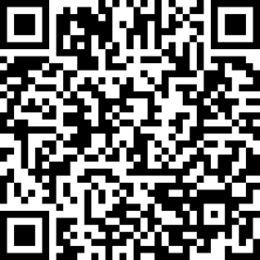
Questions?
Scan for personalized Demo

