Slide 1
Leading and Implementing Change: A Six-Month Colleague Go Live
Explore the preparation, project organization, change management, and continued enhancement planning that went into a successful implementation.
Jake Stiles, Business Analyst ​
Hannah Kannal, Assistant Director of Business Solutions​
Carroll University, Waukesha, WI

Slide 2
AGENDA
1 | Preparation
2 | Organization
3 | Change Management
4 | Continued Enhancements
5 | Lessons Learned

Slide 3
About Carroll University
Waukesha, WI
1
2
3
4
Enrollment
Class Size
Employed Faculty
Degrees
3,176 Student Body
  2454 FT UNDG
  169 PT UNDG
  553 GRAD
19.4 AVG Class Size
155 FT Faculty
233 PT Faculty
Associates – 1
Bachelors – 4
Graduate – 12
95+ Programs

Slide 4
How did we get here?
August 2023
Ellucian Colleague demos.
Oct 2023
Discovery engagements began.
Dec 2023
Configuration engagements began.
Sept 2023
Contracts with Ellucian signed.

Slide 5
Go Live
April 2024
Go Live
- Core and Financial Aid
July 2024
Go Live
- Finance
Summer 2024
Go Live
- Retention Alert, ILP, eTranscripts, Insights, and Budget Management
May 2024
Go Live
- Student, Accounts Receivable, TouchNet, and Self-Service Platform

Slide 6
Products Implemented
Colleague Key Modules​ | Colleague Supplementary Modules/Products ​ | Integrated Solutions​
Core Module​ Financial Aid Module​ Student Module​ Accounts Receivable Module​ Finance Module​ Budget Management Module​ Self-Service Module​ | Retention Alert​ Ethos​ Data Access​ Insights Reporting​ eTranscripts ​ Experience​ ILP​ | TouchNet​ SoftDocs​ Maxient​ StarRez​ Kronos​ Medicat​ Symplicity ​ EMS​
April – July 2024 Go Live​ | March – August 2024 Go Live​ | May 2024 – October 2024 Go Live​

Slide 7
Preparation
Team, Priorities, Data, and Management

Slide 8
CORE
OIT Support Team
Project Manager
Team Lead
Application Specialist
3 Developers
Project Team
CORE - BA
End Users
Full Time Business Analyst
Part Time Business Analyst
2-3 Dedicated Staff

Slide 9
Key Preparation Considerations
Student Impact
Priorities
Clean Data
End User Readiness
Focused on least interruption for faculty and students.
Decisions influenced key areas: registration, billing, and financial aid awards.
Identified essential imports, integrations, and modules for “go live”.
Deferred non-critical components for post-launch phases.
Core team members with in-depth knowledge of previous SIS data were essential.
Ensured accurate and efficient data migration.
Assessed end-user ability: turnover, technical expertise, and workload.
Allocated extra time and resources for departments requiring additional support and training.

Slide 10
Key Elements for Success
Knowledgeable Core Team
Dedicated Imports Team
Change Management
Budget Management
Experienced Business Analysts (25+ yeas in Registrar Office).
Deep knowledge of catalog, policy, and academic structure enabled quick module configuration.
Specialized Business Analyst & Developer.
Streamlined data import process.
Flexibility to adapt mid-project.
Embraced deviations from initial plans.
Budget managed by two individuals with one key decision-maker.
Simplified approval process for additional engagements, modules, and expenses.

Slide 11
Organization
Scheduling, Access, and Projects Documents

Slide 12
Key Organization Considerations
Scheduling
Divide and Conquer
Access
Escalation
Assigned specific individuals to liaise with the Ellucian PM and consultants.
Ensured decisions on scheduling are made efficiently.
Assigned core team staff to specific groups to ensure meeting representation.
Created a shared repository for documentation, training videos, and project calendars.
Facilitated easy access and collaboration.
Assigned a core team member to regularly attend University senior leadership meetings.
Provided updates and escalated critical matters as needed.

Slide 13
Key Elements for Success
Regular Meetings
Ellucian Project Site
Action Line
Tracking Systems
Developed a regular schedule of internal touch base calls outside of Colleague engagements.
Provided a space to work through issues, questions, and configuration “homework”.
Core team handled task updates and document uploads.
Saved time by reducing the need for extensive user training and inquiries.
Designated three individuals to manage ticket submissions, tracking, and communication.
Ensure efficiency and accountability in ticket handling.
Developed comprehensive tracking systems.
Streamlined accountability across all areas and enhanced team alignment.

Slide 14
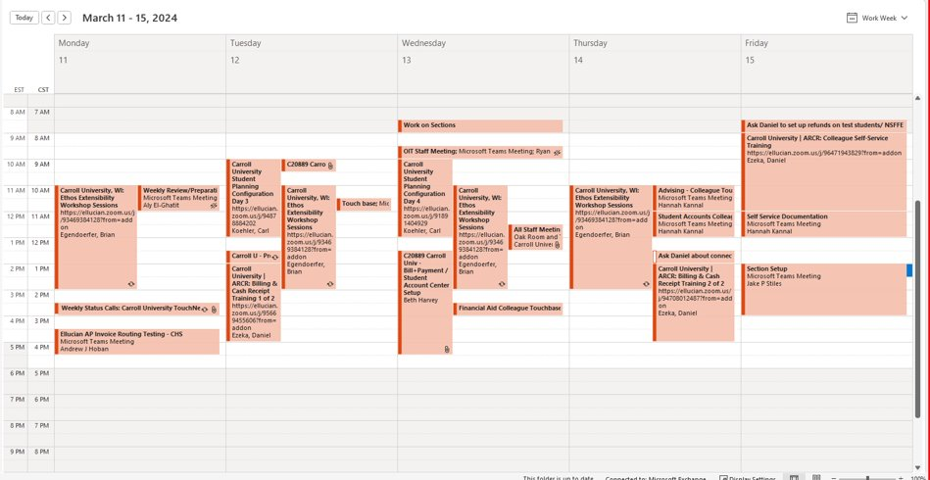
Schedule Planning

Slide 15
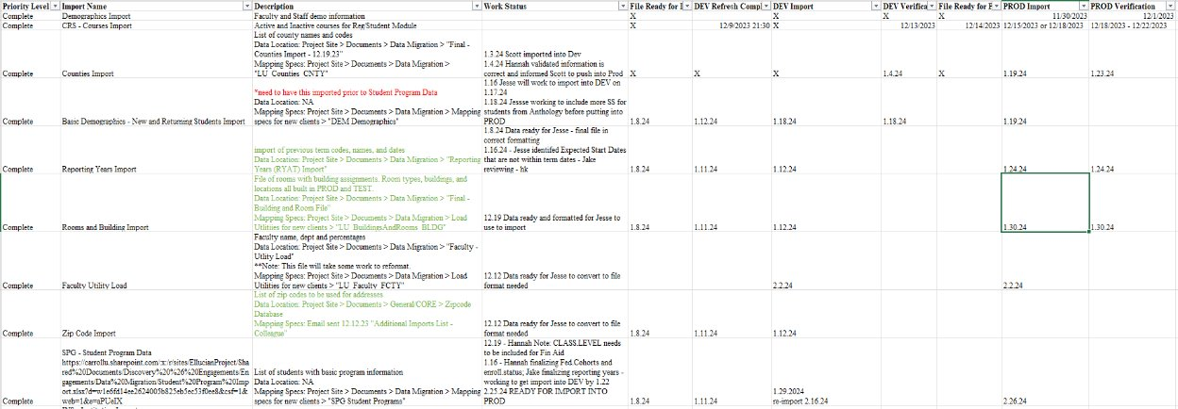
Import Planning

Slide 16
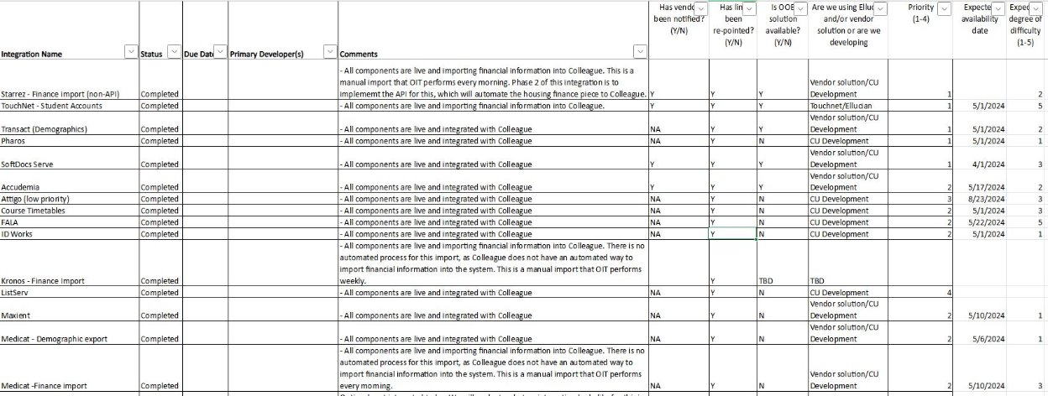
Integrations Planning

Slide 17
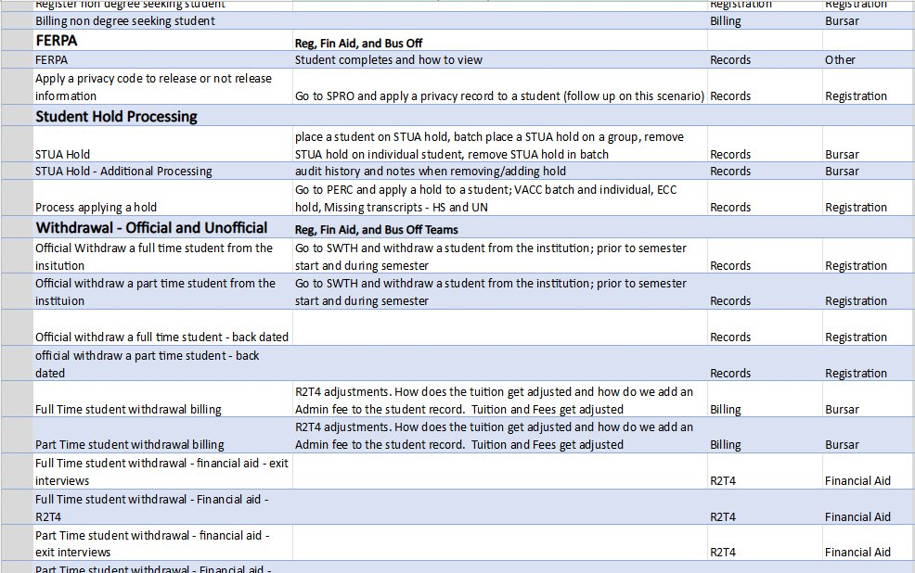
LIVE SIM Planning

Slide 18
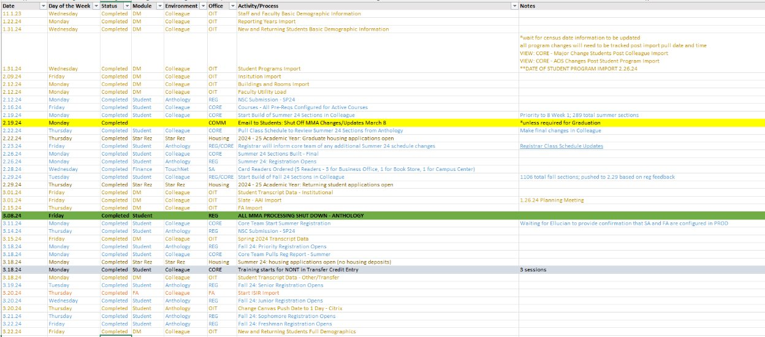
Go Live Planning

Slide 19
Change Management
Communication, Training, Implementation, and Support

Slide 20
Key Change Management Considerations
Communication
Training
Implementation
Support
Highlighted key timelines and milestones via different mediums.
Tailored communication to campus groups.
Developed comprehensive guides and quick reference sheets for ease of use.
Tailored topics to address key process workflows and responsibilities.
Designed and executed an intensive live simulation testing plan beyond Ellucian’s recommendations.
Proactively shared and collaborated on go-live planning with stakeholders.
Formed a specialized team to provide system troubleshooting and support.
Regularly met with end users to discuss current and potential system or process issues.

Slide 21
Key Elements for Success
Communication
Training
Implementation
Support
Utilized AI to streamline communication creation, saving time and resources.
Established open, consistent communication with campus stakeholders.
Centralized resources on the internal portal for quick and convenient access.
Integrated Colleague training documents to maximize efficiency and consistency.
Focused on the entire student lifecycle, ensuring all processes and interactions across offices were covered.
Incorporated key dates for all offices to align efforts and minimize disruption.
Identified and addressed concerns early to minimize impact on students and staff.
Created a knowledge base for troubleshooting.

Slide 22
Continued Enhancements
2 Years Post Go Live

Slide 23
Key Elements
Collaborative Touchpoints
Customizations and Improvements
Product Enhancements
Requests Pipeline
Continue regular check-ins with stakeholders.
Accounts Receivable – quarterly, Financial Aid – Biweekly, Registrar – Weekly, others as needed.
During rapid deployments, leveraging out-of-the-box functionality was essential.
Leverage more APIs to improve system connectivity.
Regularly check the Customer Center for upgrades and product improvements.
Work with Ellucian to identify potential new add-ons. (e.g. Smart Plan)
Developed an internal pipeline for customization, configuration, process review, reporting, and forms requests.

Slide 24
Key Elements
Automation
Reporting
Action Line
Training
Identify processes that can be improved through automation.
Streamlined workflows to enhance efficiency and reduce manual effort.
Reporting has been a key area of improvement since go-live.
Continue refining data analytics and reporting functionalities.
Established a dedicated team to handle action line tickets.
Ensure continuous follow-up and efficient issue resolution.
Intensive training was limited due to time constraints during implementation.
Completed second-stage training on advanced system features (e.g., rule writing, data fundamentals) post go-live.

Slide 25
Lessons Learned
What We Would Do Differently

Slide 26
Key Insights
Purchases
Discovery
Integration Management
Adaptability
A better understanding of purchased modules and products would have been beneficial.
Some implementations were done without fully understanding the ‘why’.
Ensure documentation is clear for all parties, including consultants.
University policies must be explicitly communicated to external teams.
Not all integrations were ready within the required timeframe.
Manual workarounds were necessary to transfer data across systems.
Emphasize the importance of being flexible.
Rely on team members, especially Subject Matter Experts (SMEs).

Slide 27
Key Insights
Maintaining Engagement
Training Approach
Documentation Challenges
Data Migration
Proactively intervene to guide conversations and maintain momentum.
Help manage expectations throughout the change process.
Self-paced videos and documentations were more beneficial than in-person training.
Implementing test groups for feedback would have been valuable.
Keeping documentation updated was difficult with the accelerated timeline.
Addressed gaps to ensure processes are documented and accessible.
Data validation will always take longer than expected.
Manual work was required for data cleanup after imports – aim for 80% accuracy.

Slide 28
v
Jake Stiles | jstiles@carrollu.edu
Hannah Kannal | hkannal@carrollu.edu ​

