Slide 1

Stop Re-Entering Data
Fixing the Campus Processes That Cost You the Most Time
Kathy Harris
Senior Account Executive
Higher Education
Notes:
- Open: thank the room, quick self-intro, name and Softdocs
- Frame it as: "I'm going to spend most of this time on problems, not products"
- Land the peer note: "if you work in Finance, HR, Registrar, Financial Aid, some of this is going to sound familiar"
- Keep it short. This slide is 30 seconds, don't linger

Slide 2




What we’ll cover today
Why it happens
(it’s not a people problem)
5 signs it’s time to simplify
What “fixed” actually looks like
How to pick your first fix
Notes:
- Key line to hit: "you don't need to fix everything at once, that's really what this session is about"
- Set expectation: a real example partway through, a practical takeaway at the end regardless of whether they ever talk to Softdocs again
- Transition: "let's start with what this actually looks like day to day"

Slide 3
The problem, in plain terms
1
Staff re-type the same information, more than once
2
Approvals vanish into an inbox
3
Records scattered across drives, cabinets, spreadsheets
Copyright 2026 Softdocs. Confidential and proprietary.
Notes:
- Paint the picture in plain, specific terms
- Examples to use live: financial aid re-keying data that already exists elsewhere; an approval nobody can locate; a spreadsheet that's quietly "the real tracker"
- Audience connection: pause after the examples, "does any of that sound familiar?"
- Key reassurance: this is close to universal in higher ed, not a reflection on any one campus
- Transition: "so why does this happen in the first place?"

Slide 4
WHY IT HAPPENS
Nobody chose this. It accumulated.
Y1
Today
New tool added to patch a gap
Another workaround, another busy season
A spreadsheet fills the gap
Each decision made sense in the moment.
The cost shows up as time, for everyone.
Copyright 2026 Softdocs. Confidential and proprietary.
Notes:
- Core message: nobody designed a process where people re-key the same data three times
- Explain the mechanism: new tool added here, workaround added there, spreadsheet built to patch a gap during a busy season. Each decision made sense in the moment
- Explicitly state: this is not about anyone doing a bad job, every office in this room has staff who are resourceful, not careless
- Land the cost: the accumulation is what shows up as lost time, for everyone touching the process
- Transition: "so how do you know if a process on your campus is ready to be simplified? There are five signs I want to walk through"

Slide 5





Five signs at a glance
Re-typing the same information
Approvals stall, no one can see where
“Did this go through?”
One document, scattered everywhere
The ”real” tracker lives in a spreadsheet
Copyright 2026 Softdocs. Confidential and proprietary.
Notes:
- Quick preview of all five before going deep on each. Orient the room
- Invite them to keep score mentally: "as I go through these, think about your own office, how many hit close to home?"
- Keep this fast, it's a table of contents, not content
- Transition: "let's take these one at a time"

Slide 6
SIGN 1 OF 5
Re-Entering the Same Information
The same data. Typed more than once.
Across different offices, different forms
Every re-entry, a chance for an error
Entered in
Office A
Entered again
in Office B
Mismatch
Risk
Copyright 2026 Softdocs. Confidential and proprietary.
Notes:
- Ground this specifically in Colleague: if the data already lives in Colleague, staff shouldn't have to retype it into a separate form or system
- Real mechanic worth mentioning, accurate, not oversold: with the right integration, a form can pull student or employee data straight from Colleague and write updates back, no separate manual step
- Two costs to name: time lost, and every re-entry is a new chance for a typo or mismatch someone has to catch later
- Audience connection: "if your staff can tell you off the top of their head, 'yeah, I enter that in two places,' that's this one, live on your campus"

Slide 7
SIGN 2 OF 5
Approvals Stalling with No Visibility
Approvals move forward… eventually
No one can say where a request actually is
“Let me check on that” becomes a full-time job
Submitted
Somewhere in review
No one knows where
Copyright 2026 Softdocs. Confidential and proprietary.
Notes:
- The "it's somewhere in someone's inbox" problem: purchase requisitions, leave requests, contracts
- Name the real cost: it's not just the delay, it's the uncertainty. The person who submitted it can't tell you where it is either
- Audience connection: ask if anyone's had to physically walk over and ask "hey, did you see this yet?"

Slide 8
SIGN 3 OF 5
“Did This Go Through?”
Students ask. Staff ask.
No way to check without asking a person
One question, asked over and over
Student asks
Staff checks manually
Answer,
eventually
Copyright 2026 Softdocs. Confidential and proprietary.
Notes:
- This is the student-facing version of sign 2, same root problem, different audience feeling it
- A student submits something and has no way to check status themselves, so they email, call, or show up in person
- Multiply that by however many students move through a process at once, it's a steady stream of status-check questions that exist purely because there's no self-service way to answer them
- Frame as: not just a staff time cost, a student experience cost too
- Transition: "next one's about the documents themselves"

Slide 9
SIGN 4 OF 5
Same Document, Multiple Places
One document. Several “current” copies.
Shared drive. Email. Someone’s desktop.
Which one’s actually right?
Drive Copy
Email Copy
Desktop Copy
Copyright 2026 Softdocs. Confidential and proprietary.
Notes:
- Shared drive, email attachment, someone's desktop, maybe a printed copy in a folder. Pick two or three, don't list all
- The real risk: someone edits one copy, the others don't update; someone leaves and takes the "only" working copy with them
- Light touch on security/compliance risk here, more copies means more places something can go missing from. Don't turn this into a scare tactic
- Keep it brief, this one doesn't need a long story to land

Slide 10
SIGN 5 OF 5
Personal Spreadsheets Tracking What the System Can’t
The real tracker? A spreadsheet.
Built because the system couldn’t keep up
When that person’s out, so is the knowledge
Gap in system
Spreadsheet
built
Knowledge walks out the door
Copyright 2026 Softdocs. Confidential and proprietary.
Notes:
- Reframe this warmly: this isn't laziness, it's the opposite. Someone being resourceful because their tools don't do what the job actually needs
- The problem: that workaround becomes load-bearing. The real status of something lives on one person's laptop, not in any system of record
- Name the risk plainly: if that person is out, or leaves, the institutional knowledge goes with them
- Audience connection: "if your campus has a spreadsheet everyone quietly knows is 'the real tracker,' that's this one"
- Transition: "so what does it actually look like when this gets fixed?"

Slide 11
Same steps. Different experience.
WHAT CONNECTED LOOKS LIKE
BEFORE | AFTER
Re-type | Enter once
Re- check | See status
Re-file | One source of truth
Notes:
- Keep this concrete, not abstract: data entered once and it flows; approval status visible to everyone involved, including the person who submitted it; one current copy of a document, not five
- Important framing: this is usually the same steps, not a different process, just a different experience going through it
- Applies to staff and students both
- Transition: "let me show you what this actually looked like at another Colleague institution"

Slide 12
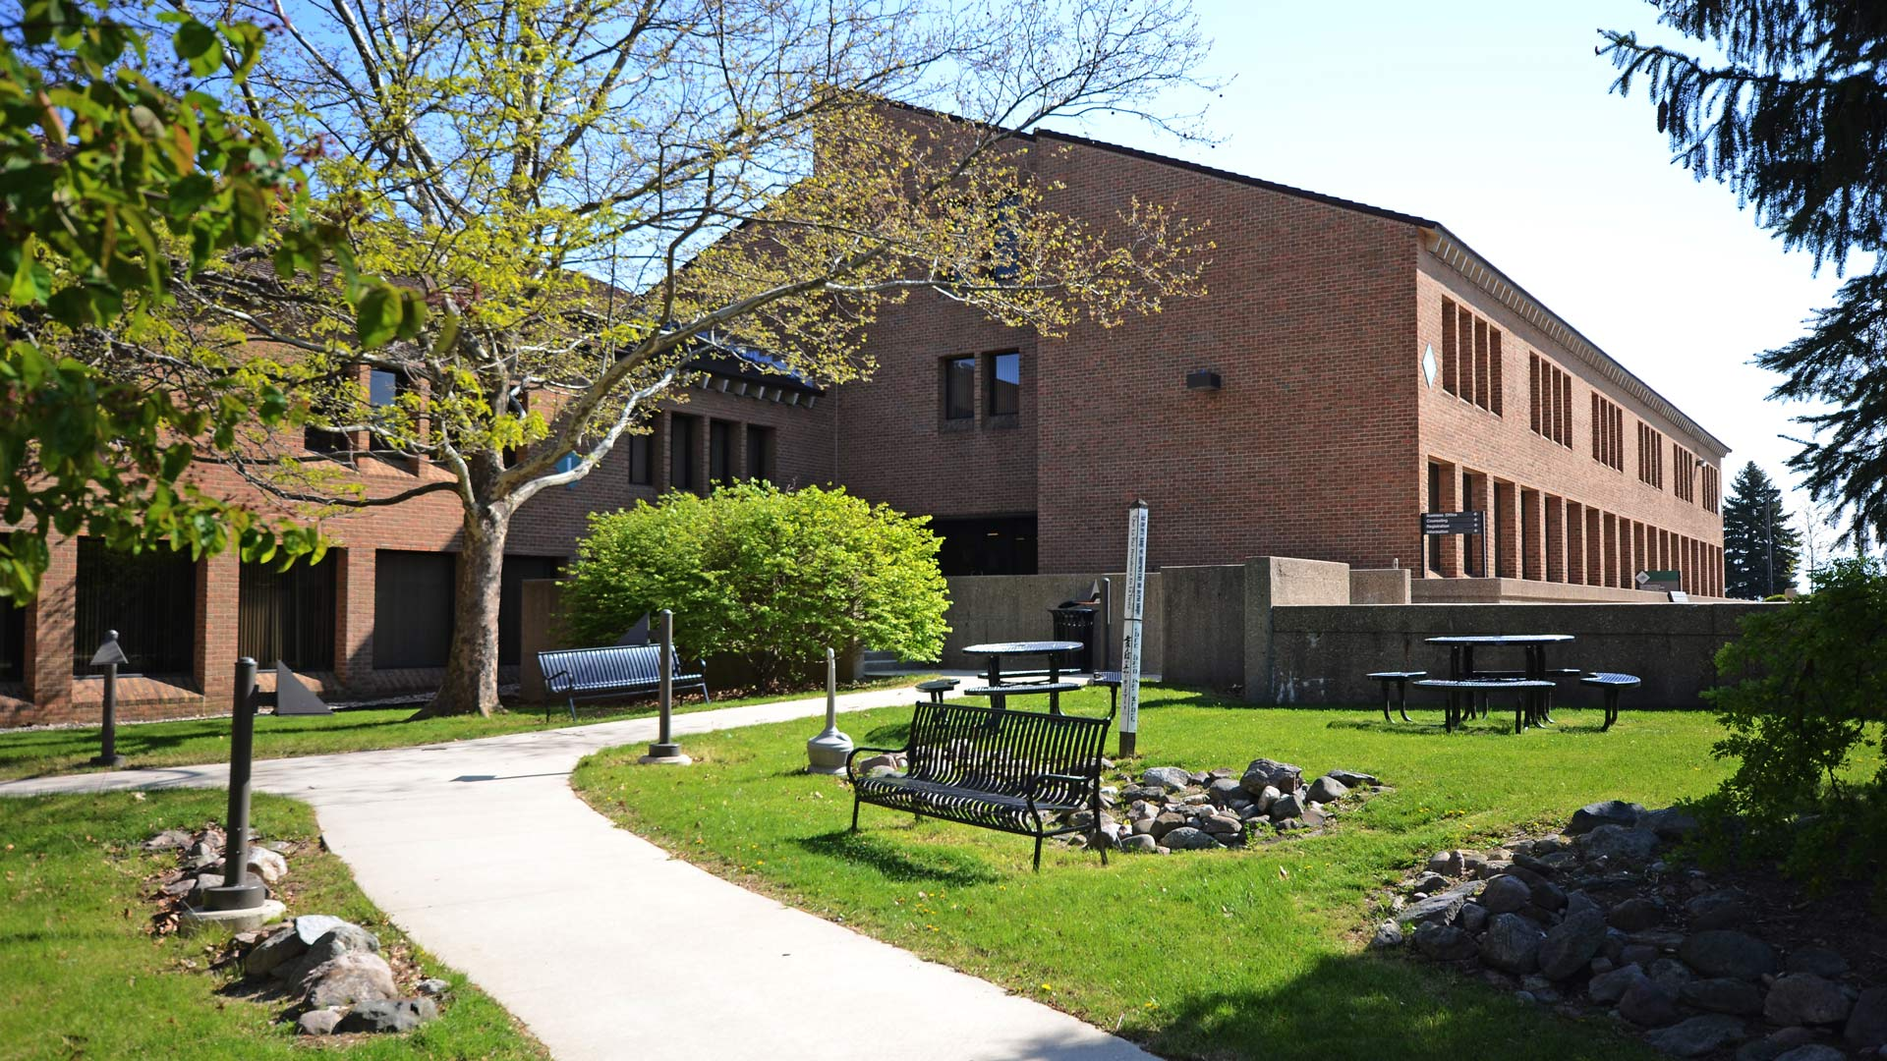
How OCC Replaced Two Legacy Systems and Saved 15,000 Hours Annually — Without Increasing Costs
Case Study | Oakland Community College
Challenges
Results
1,000+ forms managed manually via PDFs, Word docs, and spreadsheets
Outdated, siloed systems (ImageNow, Docusign) lacked scalability
Limited mobile access and accessibility compliance issues
Upcoming transition to Colleague SaaS required seamless integration
15,000+ hours saved annually — equivalent to 5–6 full-time roles
100,000+ forms processed per year
13.8% increase in enrollment, 12.7% increase in credit hours taught
No increase in operational costs
Fully integrated with Colleague SaaS and Ethos for real-time data flow
Oakland Community College (OCC), one of Michigan’s largest community colleges, serves more than 15,000 students across five campuses with a team of 1,200+ faculty and staff. Faced with outdated systems, manual processes, and growing demands for efficient student services, OCC sought a modern, integrated solution to improve operations without adding cost.
"Softdocs is the only solution that met our needs with its Ethos integration, allowing seamless data flow and pre-population of forms, which significantly improved data standardization and user experience. This was critical to support our migration to Colleague SaaS. The partnership with Softdocs has been exceptional. Whenever we encounter a challenge, their team is quick to respond and provide solutions, making them a critical part of our technology stack and strategic initiatives."
Chuck Flagg | Executive Director of Technology Infrastructure

Slide 13
The Integrated Etrieve Platform
Etrieve
Content
Document Management
Etrieve
Forms
Electronic
Web Forms
Etrieve
Flow
Process
Automation
Etrieve Document Signatures
PDF Signatures
Intelligent Document Processing
Intelligent Capture
Intelligent Transcript Processing
Transcript Capture

Slide 14




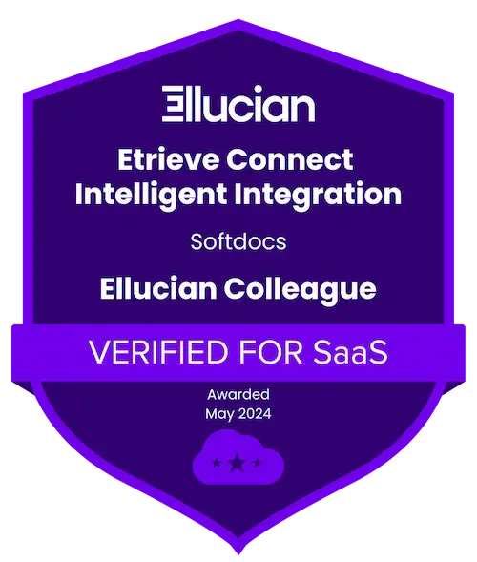

What working with Softdocs looks like
MORE THAN A PLATFORM
One flat cost,
no hourly surprises
Hands-on training in your live system
A team that stays past go-live
Notes:
- Open by naming the product plainly: "what we build is called Etrieve, that's the platform. Softdocs is the company behind it"
- Open with the Colleague-specific fact, it's real and relevant to this exact room: Etrieve is Ellucian Verified for SaaS for Colleague, and per our own numbers, it's the largest document management and process automation platform in the Ellucian ecosystem, running at hundreds of Banner and Colleague schools today
- Second point: implementations are scoped against a custom SOW with one flat fee, no hourly billing, no surprise overages
- Third point: training happens hands-on, in your own live instance, on your actual forms and processes, not a generic demo environment
- Fourth point: after go-live, ongoing Managed and Premier services exist for institutions who want an extension of their own team, not just a vendor who disappears after the contract's signed
- Keep this entirely first-person about Softdocs and Etrieve, no comparisons, no "unlike other vendors," just what's true about this one
- Transition: "so with all that in mind, where do you actually start?"

Slide 15
FINDING THE ONE THING WORTH FIXING FIRST
Score it. Start where it counts.
START HERE
5
1. Retyping data
2. Stalled approvals
2
4
1
3. “Did this go through?”
4. Duplicate Docs
5. Spreadsheets
X-axis: how often it happens
Y-axis: how risky or visible the pain is
3
Copyright 2026 Softdocs. Confidential and proprietary.
Notes:
- Reassure first: five signs is a lot, you don't need to tackle all five at once
- Three questions to filter with:
- How often does this happen? Something that happens 500 times a semester beats something that happens 5 times
- What's the risk if it stays broken? Just annoying, or real compliance, security, or data-integrity exposure?
- How visible is the pain? Are people actively complaining, escalating, working around it?
- The process scoring high on all three, that's the one worth starting with, not the biggest project or the most impressive fix
- Audience connection: invite them to think of one process in their own office right now, silently, and see if it scores high on more than one axis
- This is the slide to slow down on, it's the actual takeaway, give it room

Slide 16








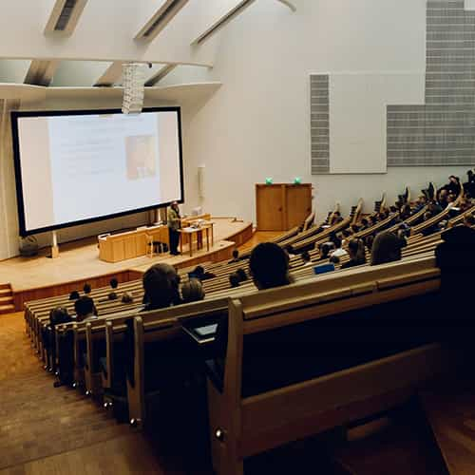

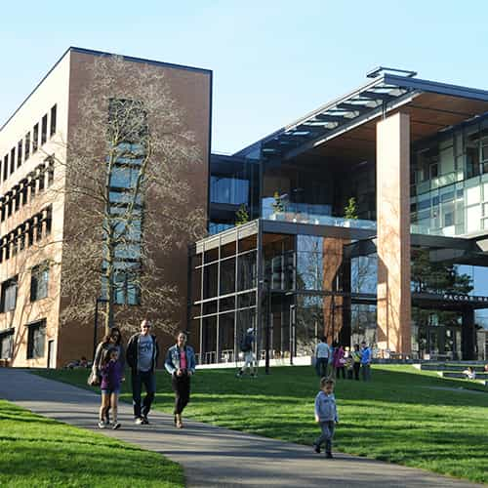






Pick one thing.
Start there.
Questions?
Kathy Harris
kharris@Softdocs.com
Notes:
- Recap fast, one line each: nobody's doing anything wrong, it accumulated; five signs, you just walked through them; fixing it looks like the same work with visibility; pick the highest-scoring one and start there
- Open for questions, mention you'll also be at the table afterward for anyone who'd rather talk one-on-one
- Keep the close warm, thank the room for their time

