Slide 1
AI-powered Analytics and Fraud Detection
John Van Weeren – VP, Higher Education
Emily Bonham – Sr. Analytics Manager

Slide 2














20+ years
70+ institutions
Student Success Analytics
Fraud Firewall
Assessment and strategy
Data governance
Data integration/warehousing
Data modeling and visualization
Analytics platform admin/hosting
Customized training

Slide 3

Institutional Data Journey
Cumbersome – daily enrollment numbers were staff-generated and manually compiled ​
Trends Missing – limited availability of visuals such as line graphs and pie charts​
Data Sources Limited – reporting was only done on Colleague data, missing data elements from other sources such as Recruit or National Student Clearinghouse​
Inconsistent Definitions – for example, "student" means different things to different people

Slide 4
Student Success Analytics (SSA) Cloud
Human
Resources
Finance
Student Lifecycle
Student Learning/Engagement
Readiness/Developmental Ed
Degree Audit/Program Progress
Program Review
Admissions
Financial Aid
Advancement
Alumni
Enrollment
Retention/Persistence
Course Demand
Scheduling Efficiency
Graduations/Completions
Transfers
Career Success

Slide 5

Admissions Fraud - History
Some fraudulent applications turned into many
Admissions staff flagged:
  name entered all in CAPS
  email address “@yahoo.com”
  Social Security Number not starting “15”
  100% online program selected
They did time-consuming manual checks:
  Requesting identity verification from applicants
  Checking whether address was listed for sale
Even with these additional checks, they weren’t catching all the fraud and also wasted time on a lot of legitimate students

Slide 6


Evolution of Fraud
  Stolen identities of real people
  AI generated documents, photos, voice, and videos
  AI bots emulating human behavior
  Actual people, not just bots
  Fake generated data
  Easy to spot patterns of unlikely circumstances
  Bots pushing volume

Slide 7
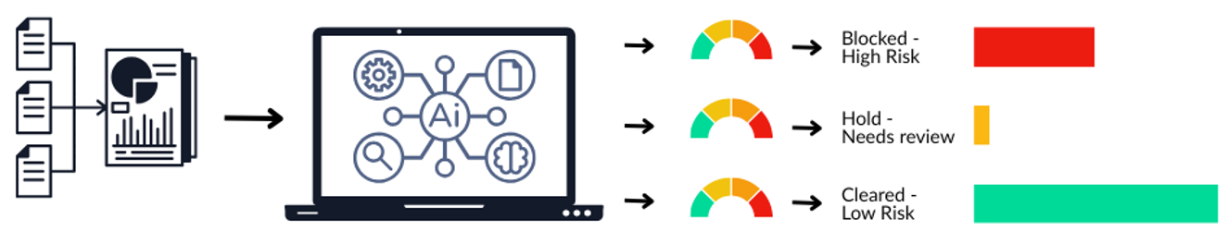
The Process in Three Steps
1 Consolidate Data 2 Evaluate using AI 3 Automate Processing Actions

Slide 8
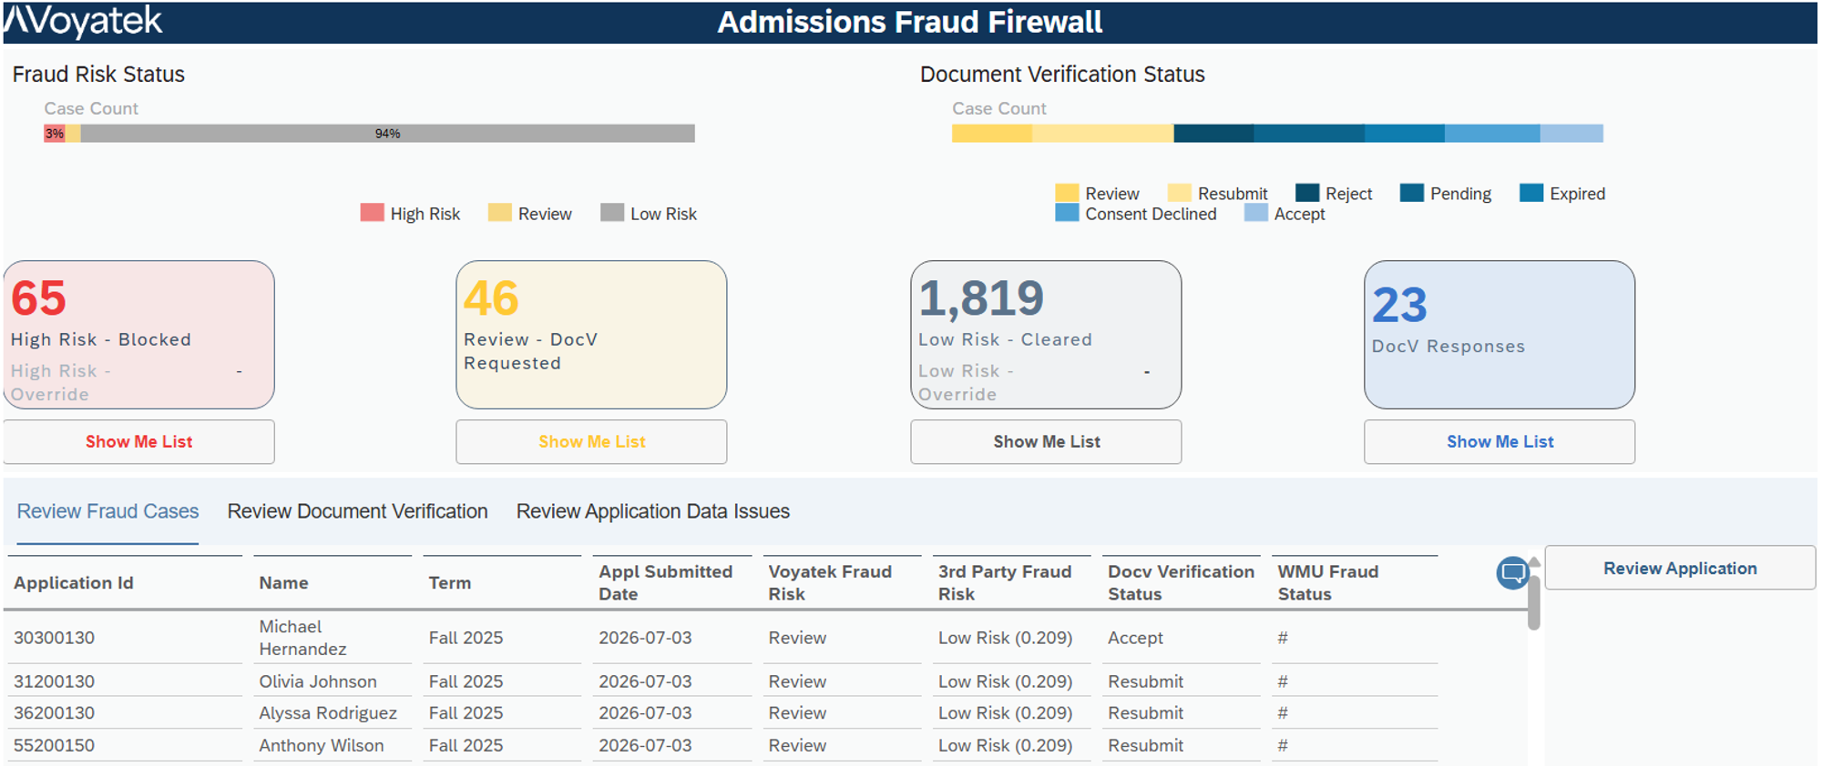
Application Fraud Detection - Business Process Flow
Status Trigger
Auto Accept
Application Entered in CRM
Processed in AI Models
Moves Into SIS
Manual Review
Auto Reject
Auto Review - DocV
Confirmed Fraud or No Verification Response
Confirmed Not Fraud
Application Review
Investigative Tools, Document and Selfie Verification

Slide 9
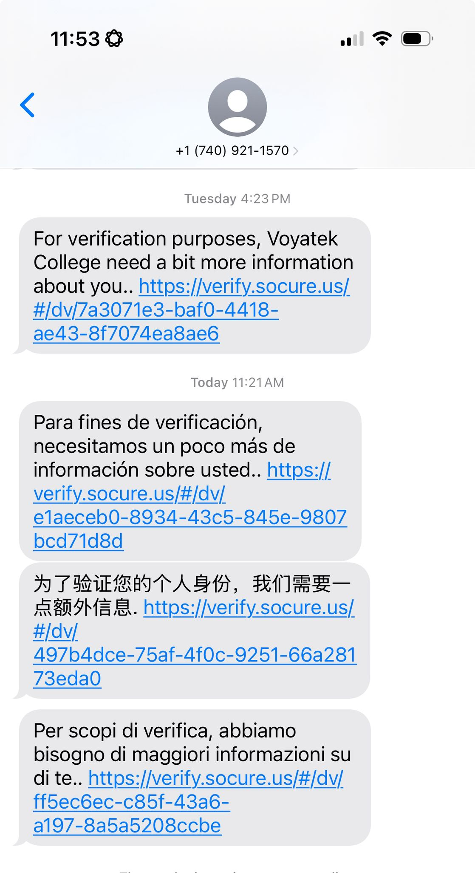
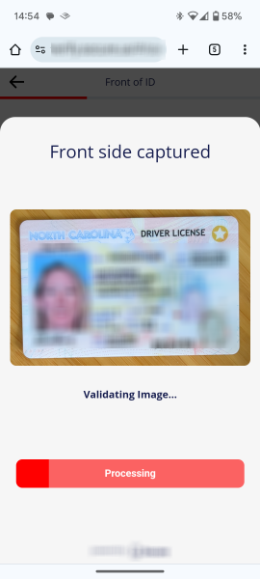
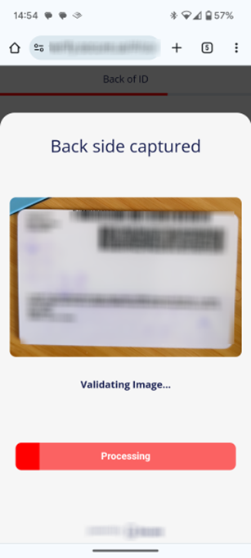
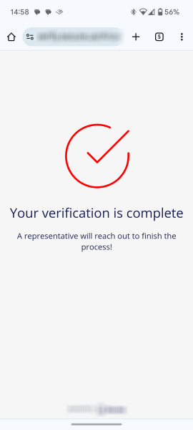
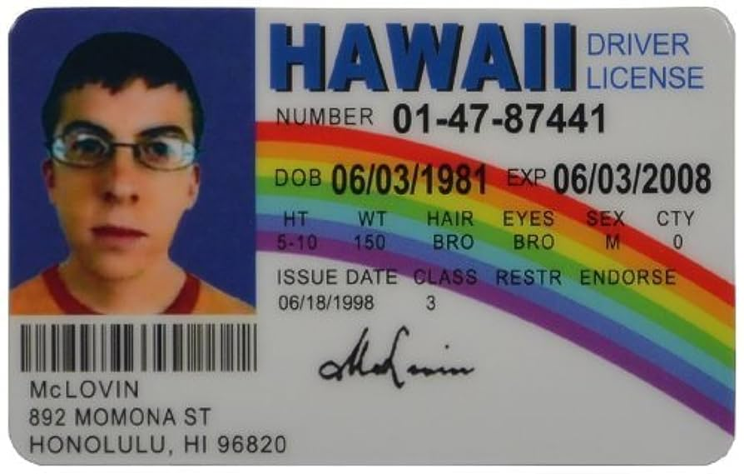
The Applicant Experience

Slide 10

Admissions Fraud Dashboard

Slide 11
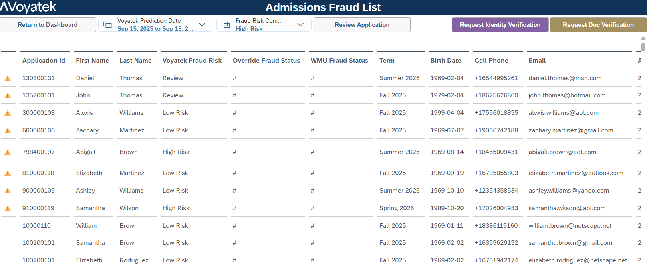
Admissions Fraud – Review and Case Management

Slide 12
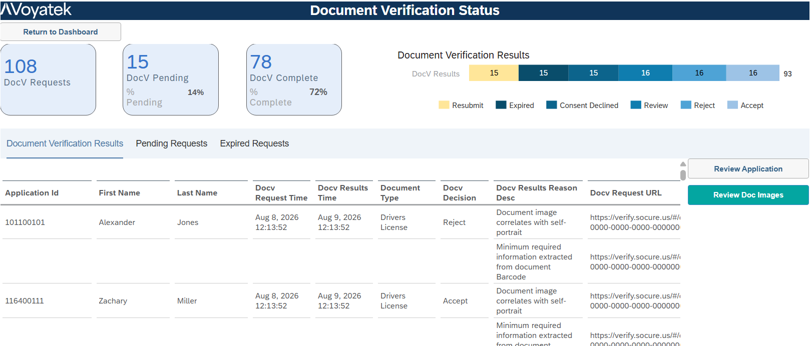
Admissions Fraud – Document / Selfie Verification

Slide 13
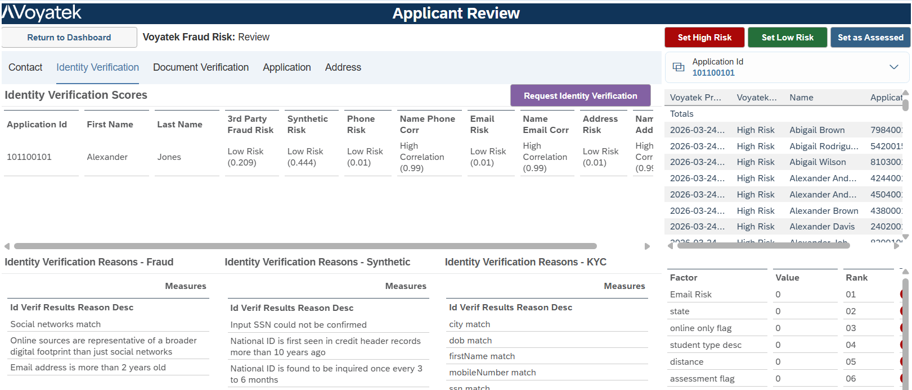
Admissions Fraud – Detailed Analysis and Evidence

Slide 14
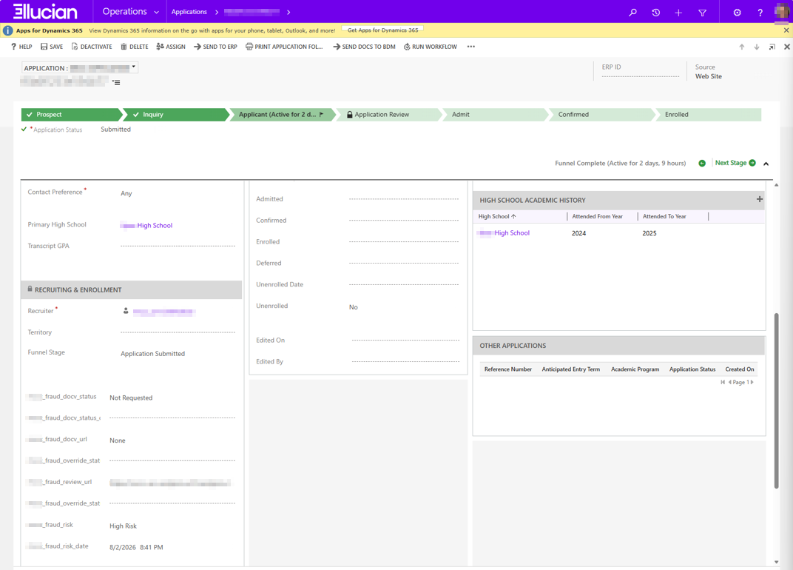
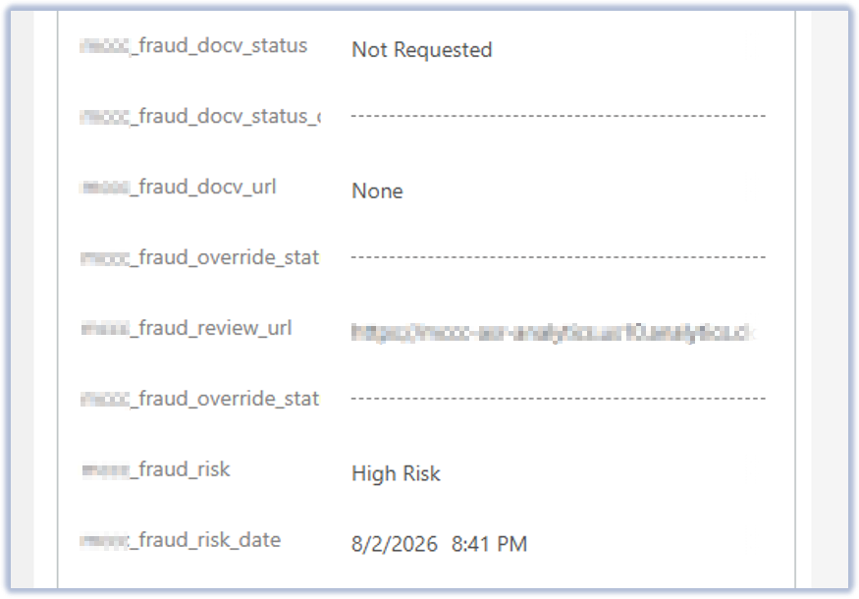
Admissions Fraud – CRM Write-back

Slide 15
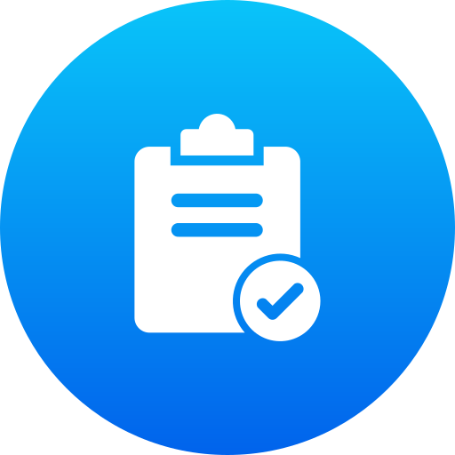
Admissions Fraud - Outcomes
Automated document review for medium-risk students
Staff no longer need to Google & guess
Staff have more time to deal with actual admissions functions
Fewer fraudulent students make it into Colleague

Slide 16
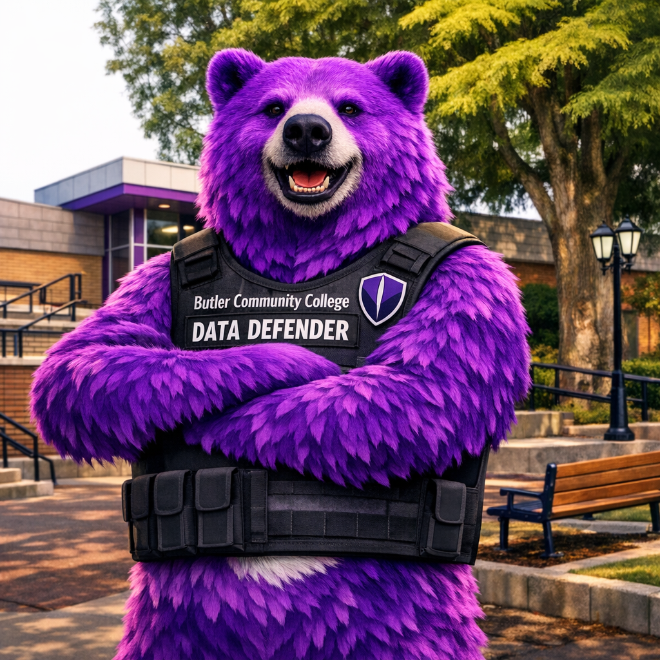

Real-world Story
80% reduction in manual review
Hundreds of hours saved per month
100 fewer admits per month
No impact on enrollment

Slide 17

Solution Benefits and Why it Matters
Fewer fake students, more time for real ones
– a win all around!
Fraudsters are sophisticated and collaborate better than we’d like
– so, we need better tools too!

Slide 18
Fraud Firewall: Seamless, Complete Platform
Currently in Preview
2H 2027
Currently Available
...AND BEYOND
ADMISSIONS
APPLICATION
FINANCIAL AID
APPLICATION
PASSWORD, MFA RESET/
ACCOUNT RECOVERY
Email / phone / device risk
REMOTE PRESENCE
TRANSACTIONS
New bank, transcripts,
online exams, remote employees, etc.
IAL2 / V4 Verifications

Slide 19
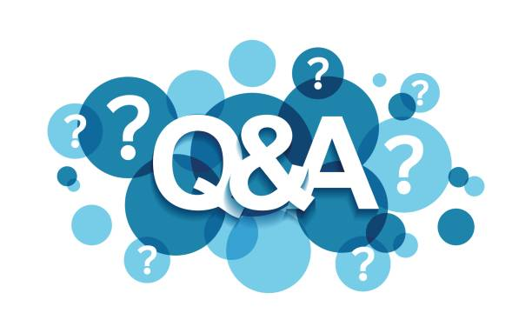
Questions?

Slide 20
Thank you!
John Van Weeren: john.vanweeren@voyatek.com
Emily Bonham: emily.bonham@voyatek.com

