Slide 1
From Data to Decisions: Intelligence and Automation for Smarter Academic Operations
September 2026 | Presented By: Nikki Pulido

Slide 2

Nikki Pulido
Regional Sales Director, Coursedog

Slide 3
1
Introductions
The Connection Between Analytics & Academic Ops
Scheduling Analytics for Student Progression
Curriculum Management to Support Student Outcomes
Driving Curricular Change
With Assessment
Q&A
2
3
4
5
6

Slide 4
What You’ll Leave with Today
Why academic operations friction is everyone’s problem, not just the registrar’s
How scheduling, curriculum and assessment are some the levers that decide whether a student finishes, and what it costs you when they don’t
3 practical ways you can act on quickly - you don’t need a 5 year roadmap to get there.

Slide 5


What Are Academic Operations?
“
Curriculum management
Syllabi management
Catalog management
Classroom space management
Class scheduling
Credential audit and completion processing
Class registration
Institutional and/or programmatic accreditation
Proficient, efficient academic operations contribute to learner success, persistence, and completion.
- AACRAO
Source: “Academic Operations and the Role of the Registrar,” AACRAO, April 2024.

Slide 6



How are Students Impacted by Academic Operations?
Data from 1.5k college students across 75 institutions
Pre Registration
Registration
Post Registration
1 in 4 Students
find it difficult to understand degree requirements.
3 in 5 Students
struggle to enroll in
required classes.
1 in 3 Students
consider leaving due
to inability to enroll in
required classes.
Source: “Student Barriers to Navigating Academic Life,” College Pulse, 2022.

Slide 7





Results You Can Count On: Strong Value Delivered in Three Key Areas
Enhance Student Success
Increase Operational Efficiencies
Optimize Faculty & Resource Allocation
5%
Student enrollment with strengthened curriculum innovation and branding
(25% attributable to Coursedog)
75%
Time spent managing scheduling, booking requests, and resolving conflicts
0.5%
Annual overall faculty costs/budget
50%
Annual off-campus room leasing costs
3%
Student retention / timely
degree completion
(50% attributable to Coursedog)
85%
Time spent on catalog development
and updates
80%
Time spent on curriculum development and updates, and 50% reduction in time spent on syllabus creation and updates
0.5%
Annual state funding, with improved evidence of student performance
90%
Time spent on assessment planning, data collection, and reporting
Statistics collected by third-party research firm

Slide 8
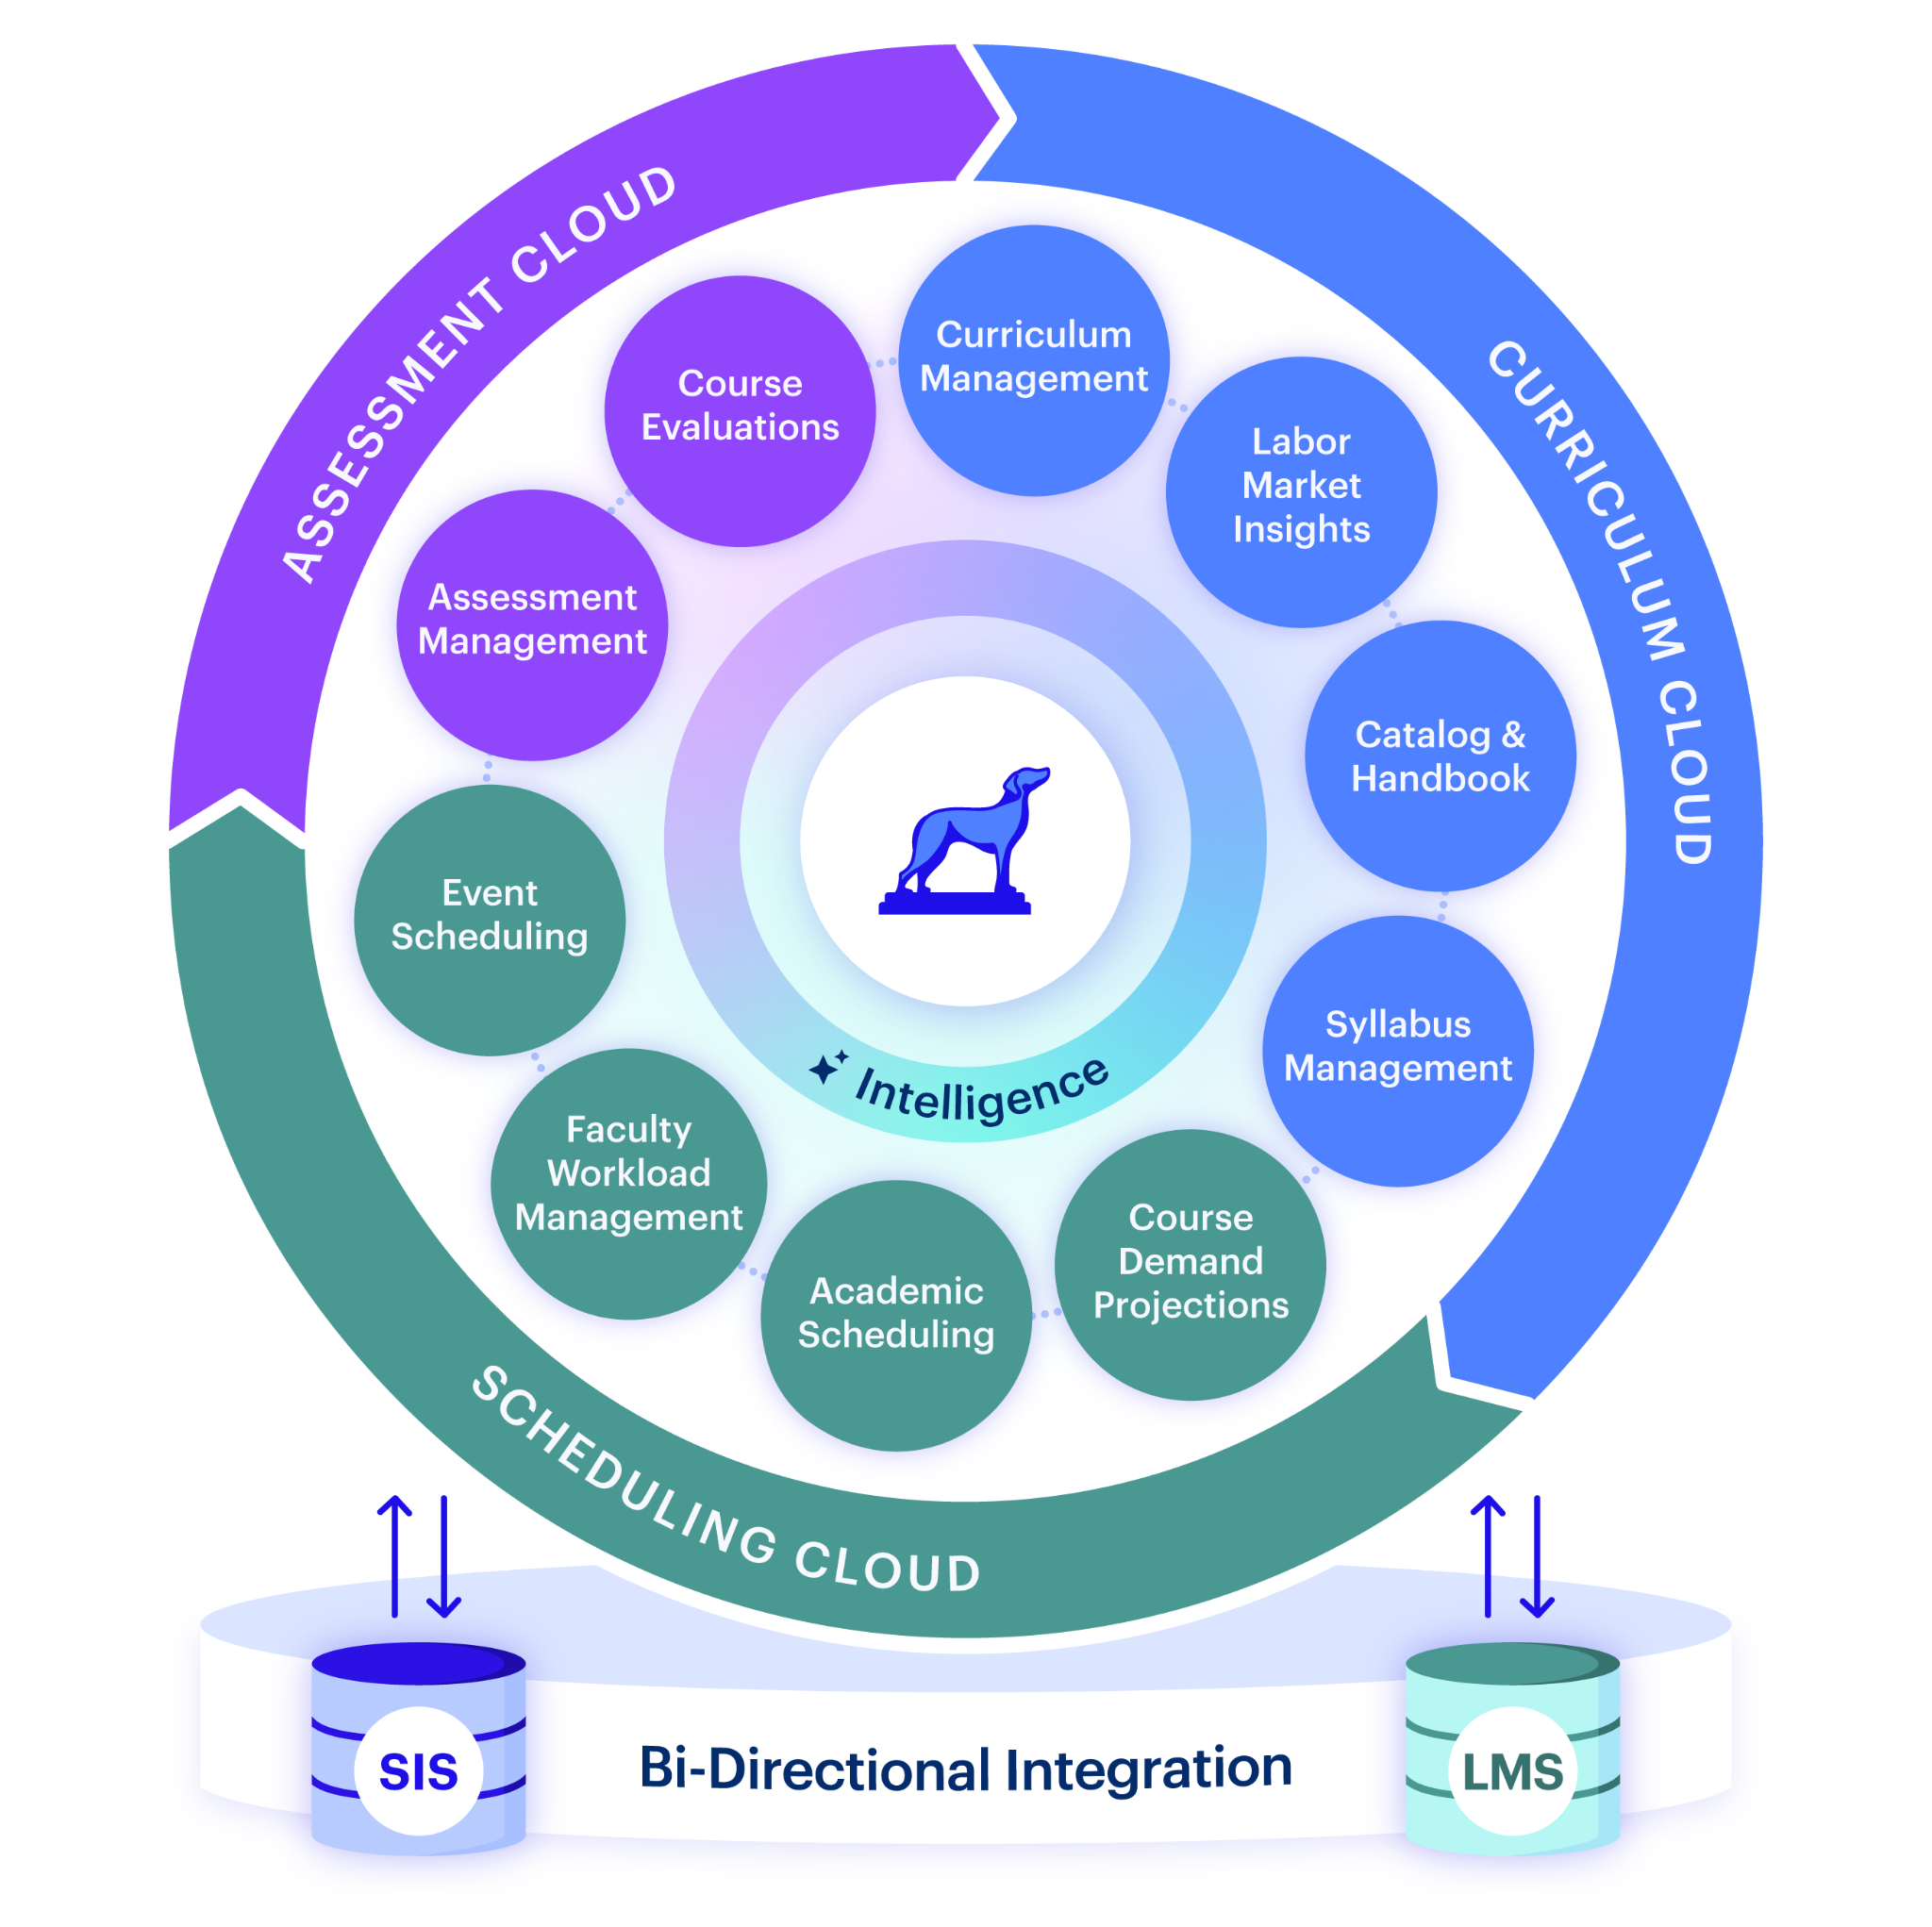










SERVING 500+ CAMPUSES WITH 3.5M+ STUDENTS
SIS Bidirectional Integrations
Homegrown
API Solution
LMS Bidirectional Integrations

Slide 9
Taking a Holistic Approach to Academic Operations Data
From Data to Decisions: Intelligence and Automation for Smarter Academic Operations

Slide 10




Significant Opportunities to Leverage Data
Across Academic Operations
74% of institutions do not agree that they participate in student-centric scheduling
37% of institutions use data to project course and program demand
74%
37%
37% of institutions disagree that they use data effectively to support curriculum management, catalog administration, and classroom space management
8% of undergraduate institutions have a significant predictive analytics strategy with dedicated staff to leverage degree audit data
37%
8%
Source: "A Comprehensive View of Undergraduate-Class-Scheduling Practice, Policy, Data Use and Technology," AACRAO, October 2022; "Class and Academic Program Demand Practices," AACRAO, August 2022; "Use of Degree-Audit and Education-Planning Solutions," AACRAO, November 2022.

Slide 11
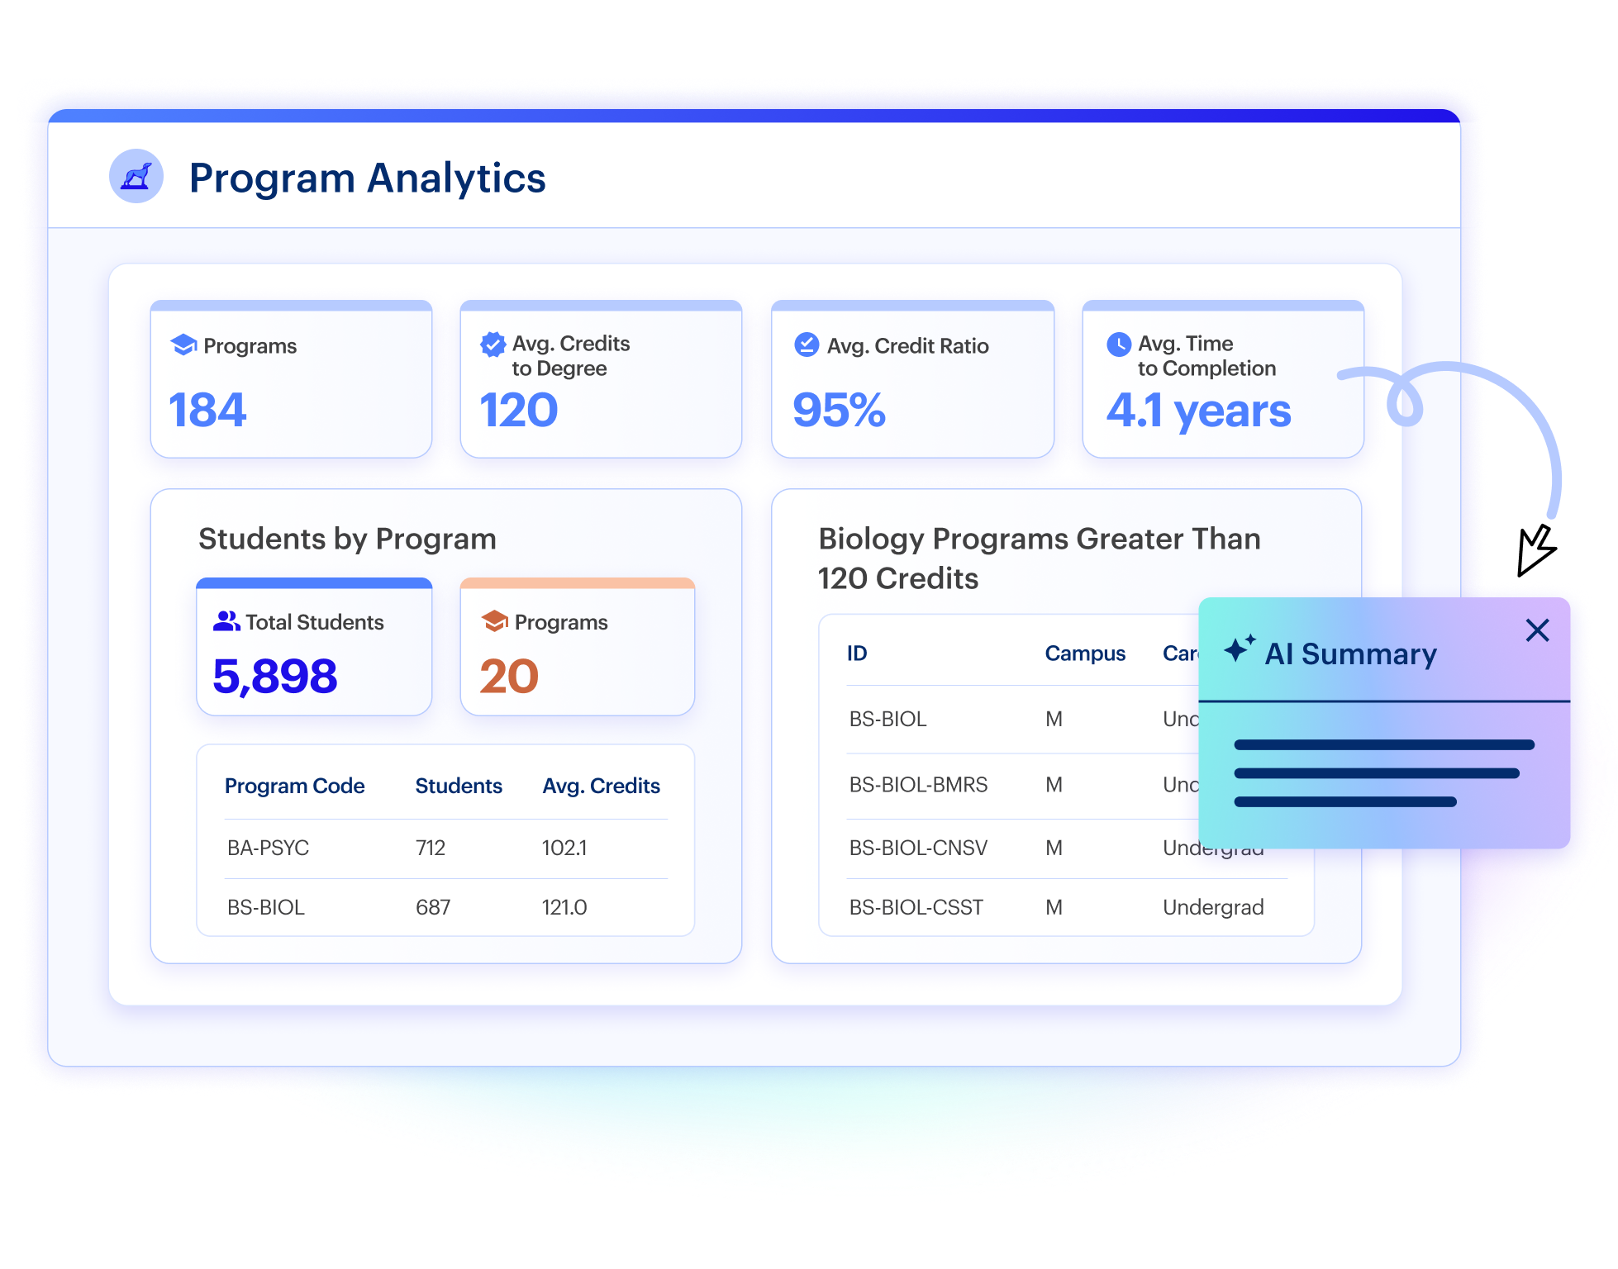
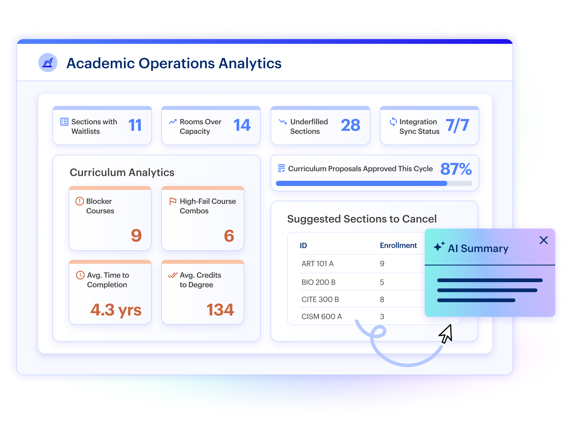
Intelligent Reporting You Can Act On
Intelligent Reporting: Monitor and analyze real-time, day-to-day operational data with flexible reporting that goes beyond static dashboards.
Platform-Wide Intelligence: Anticipate the downstream impact of academic changes before you act on them.

Slide 12
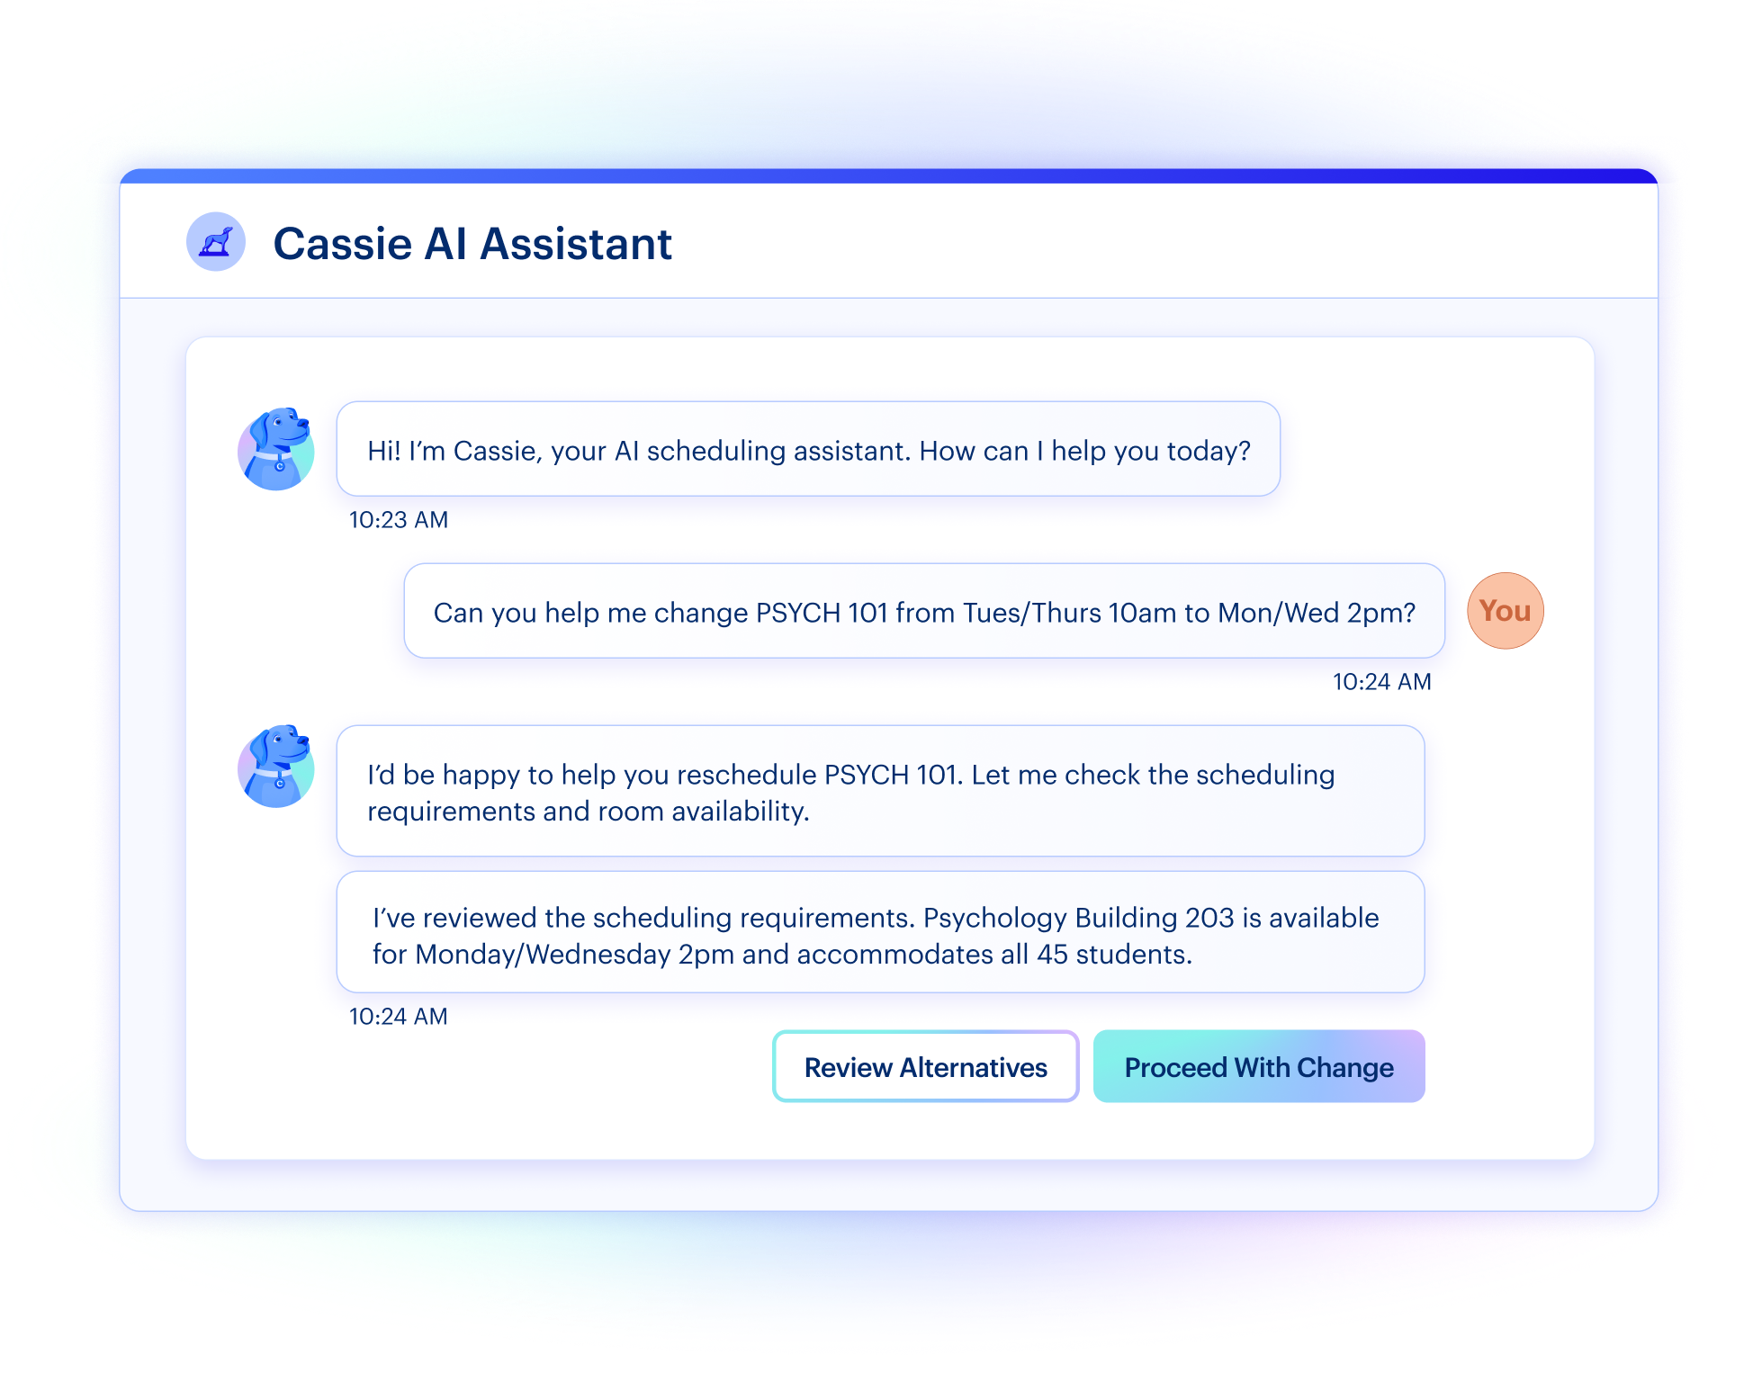
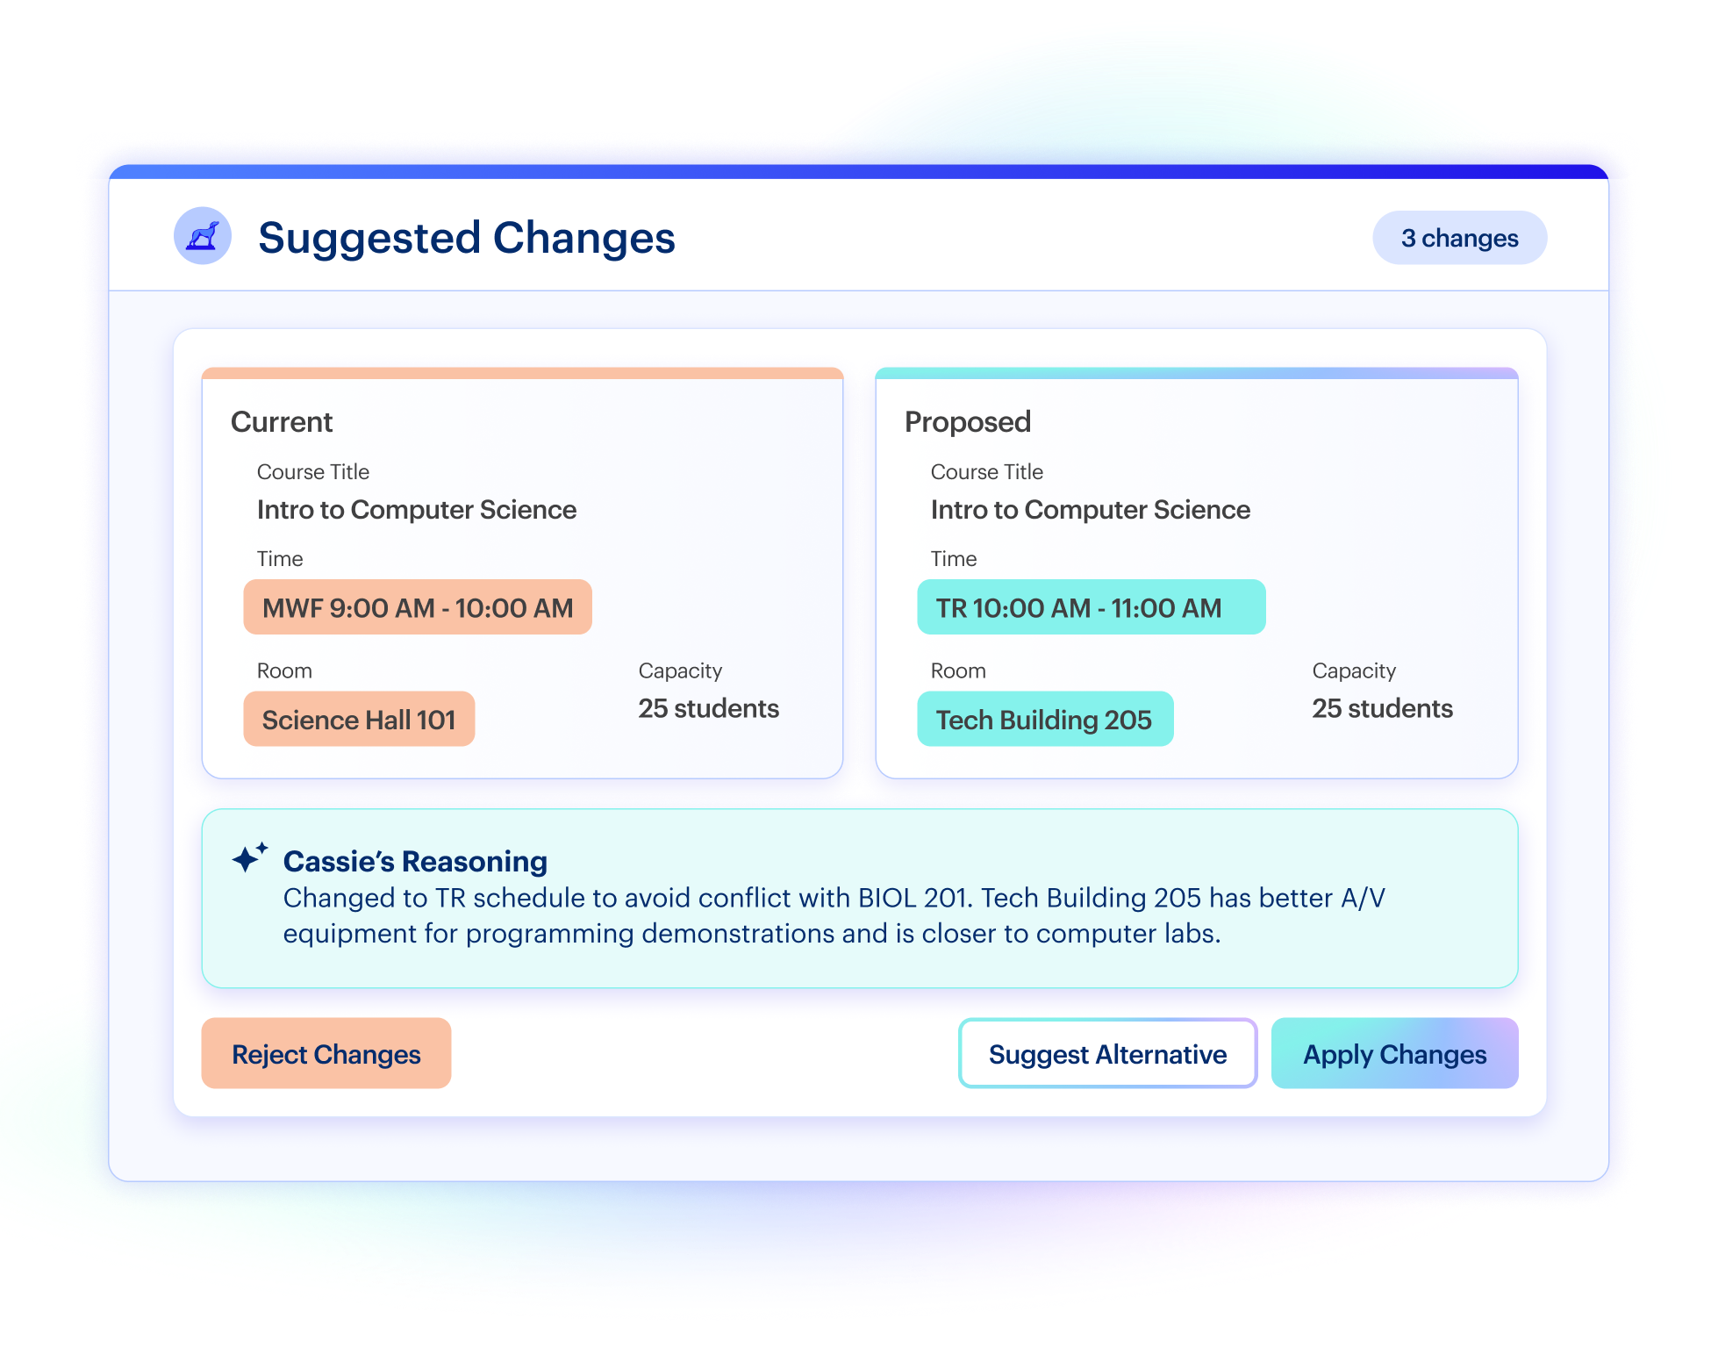
Accelerate Knowledge & Decision-Making
NEW
NEW
Ask Cassie: Ask questions about your data and get instant answers without exports, external tools, or manual analysis.
Context-Based Recommendations: Get actionable guidance grounded in your data, workflows, and rules to quickly align your processes with best practices.

Slide 13




Using Analytics in Academic Operations
To Enhance Student Outcomes
Individual student-level intervention, without scheduling and curricular changes, does not get to the root of the issues that impede student progression
Analytics transform curriculum management and academic scheduling into levers that impact student outcomes
Streamlined academic operations result in enhanced data governance, which is the foundation to an effective data-driven culture
Analytics remove the guesswork on the operational side to enable purposeful decision making

Slide 14
Scheduling
Analytics for Student Progression
From Data to Decisions: Intelligence and Automation for Smarter Academic Operations

Slide 15
Scheduling for Student Progression:
Two Core Principles
01
02
Offer the right classes and seats
Offer sections at the right time
Plan course offerings based on student demand and ensure students have access to the courses they need according to their pathways. Evaluate the following:
Section fill rate trends across like terms
Demand by modality, campus, time of day
Students in need of requirements (especially rising seniors)
Make time assignments that reduce the likelihood of introducing conflicts in the student schedule. Review the following:
Distribution across time and days of the week
Conflicts with other sections likely to be taken based on degree pathways

Slide 16
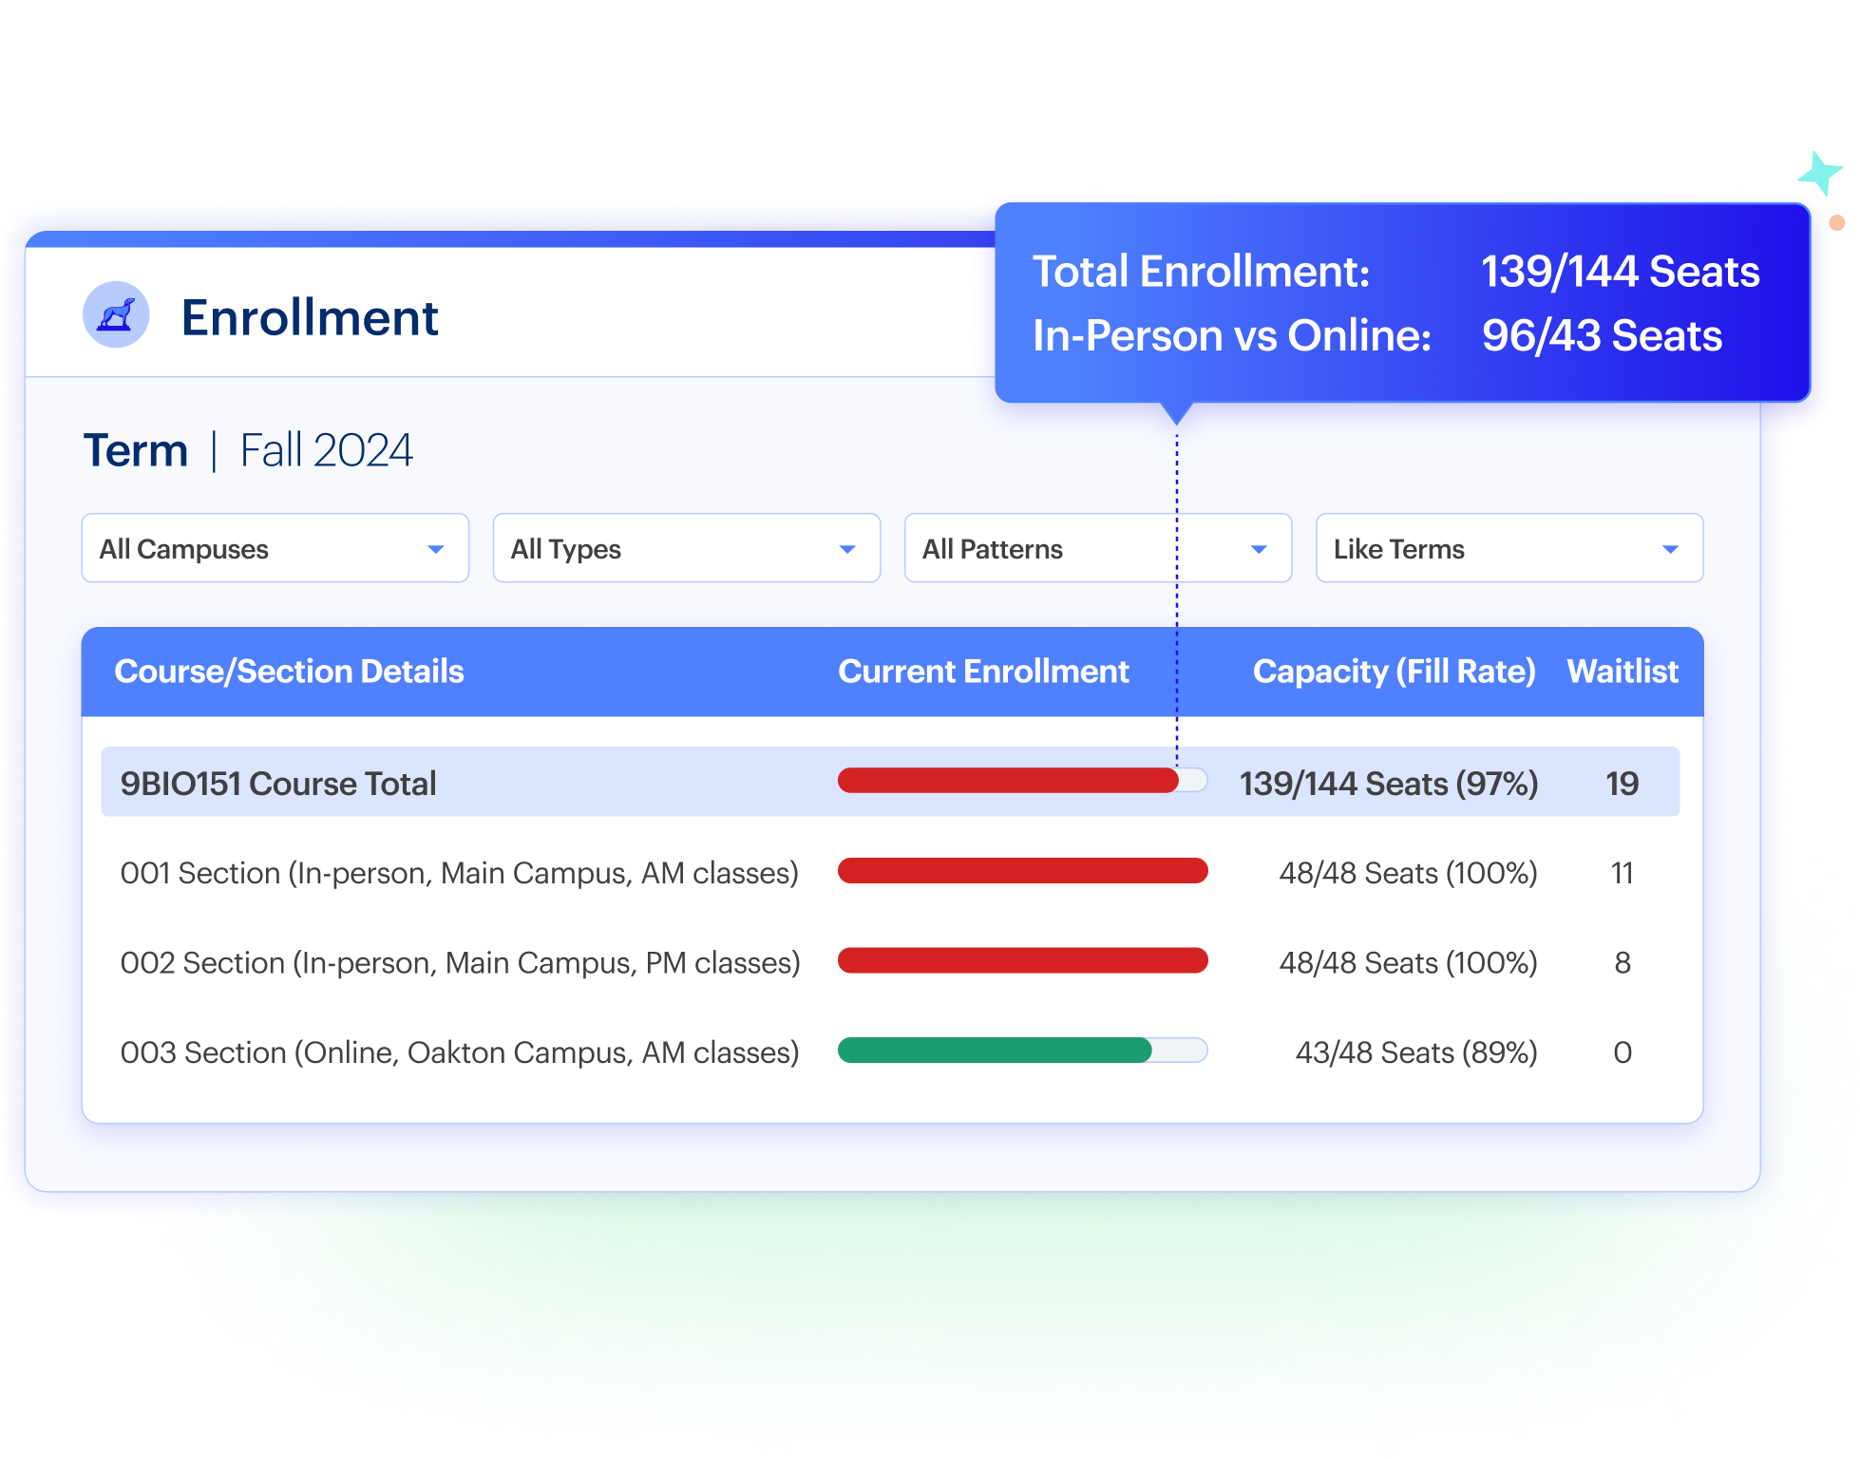
Scheduling for Student Progression: Example

Slide 17




Benefits of Using Analytics to
Project Course Demand
Increase Student Course Access
Offering the right sections, at the right time increases student accessibility, with positive effects on number of credit hours taken and time to completion.
Proactively Predict Demand
Additional data sources from degree audit data provide a forward-looking analysis of sections needed.
Improve Resource Utilization
Reducing overfilled and underfilled sections allows institutions to more efficiently use space and allocate instructional resources.
Boost Enrollment Numbers
Retain more students by keeping them on the path to completion and reducing frustration with course accessibility.

Slide 18
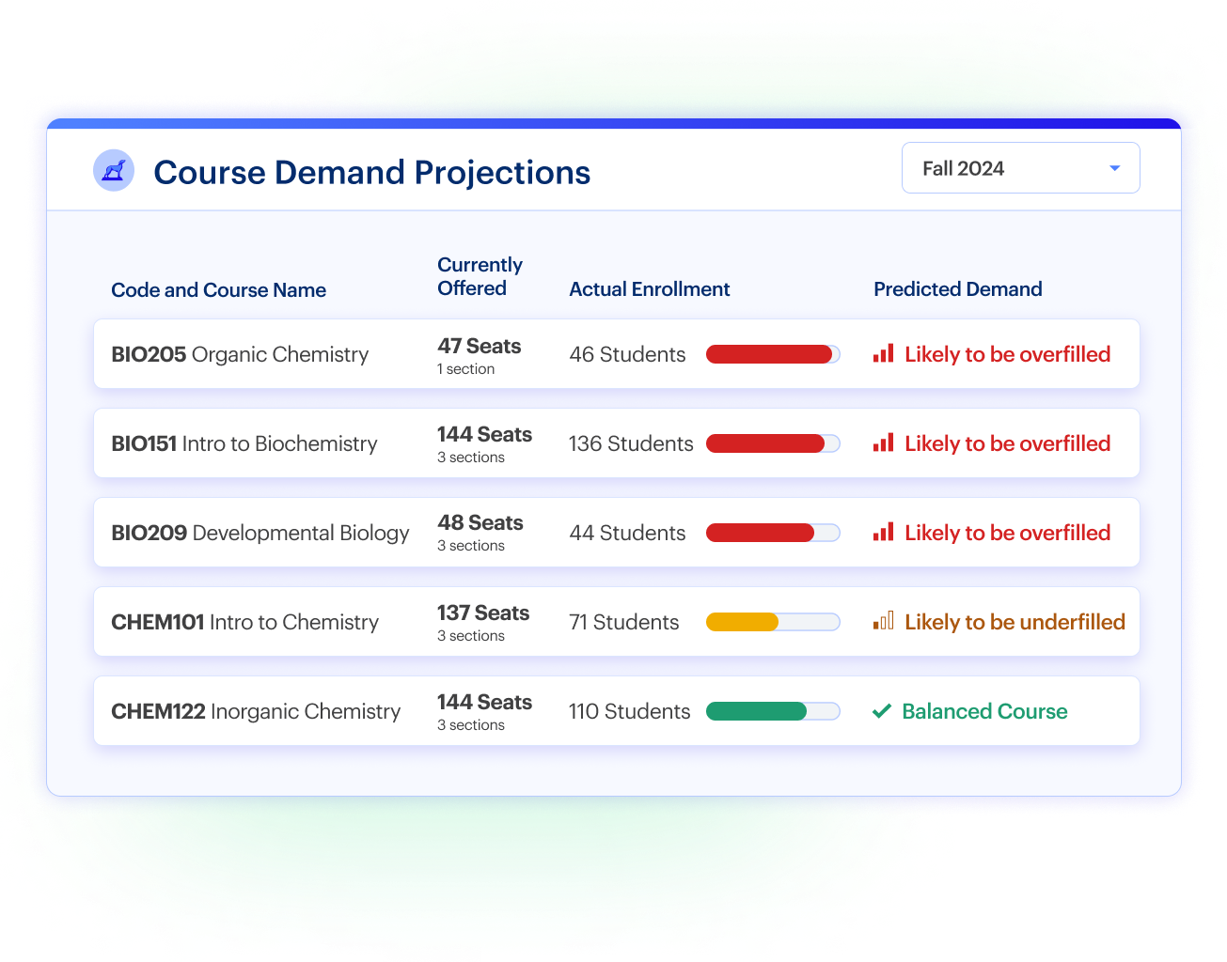
Course
Demand Projections: Example

Slide 19
Curriculum Management to Support Student Outcomes
From Data to Decisions: Intelligence and Automation for Smarter Academic Operations

Slide 20


Pillars of Student-Centric Curriculum Management: Three Core Principles
Supercharge Program Progression
Remove Barriers to Course Completion
Reallocate
Curricular Dollars
Analyze key metrics like credits to degree, productive credit ratio, and time to completion to measure program health. Intervene at the first sign of program attrition.
Review risky course combinations, prerequisite effectiveness, and drivers of low completion rates when making curricular changes.
Evaluate financial health of course and program offerings in order to sustain retention and enrollment.

Slide 21
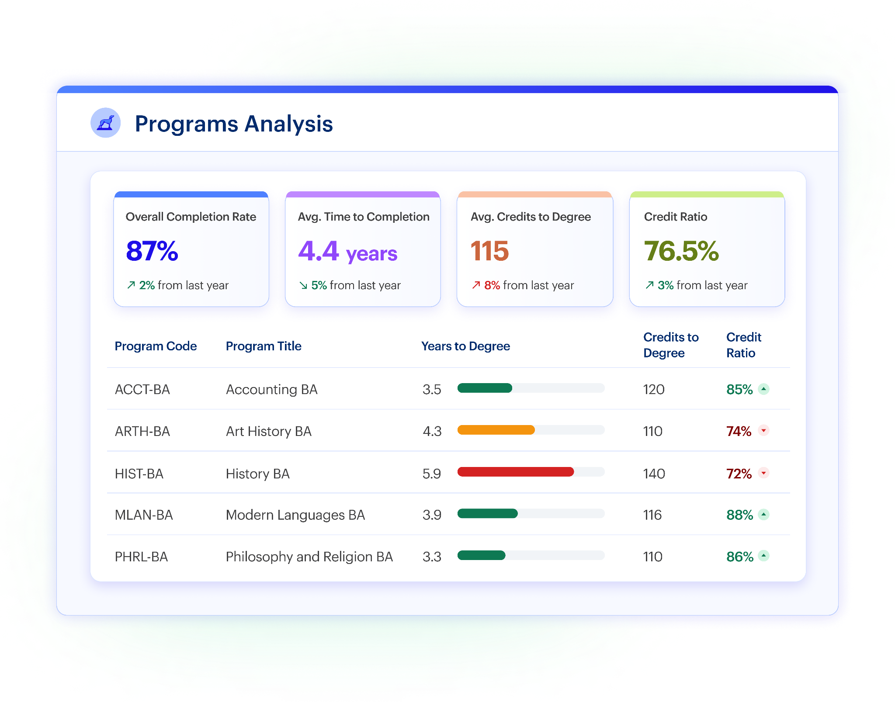
Supercharge Program Progression: Example

Slide 22
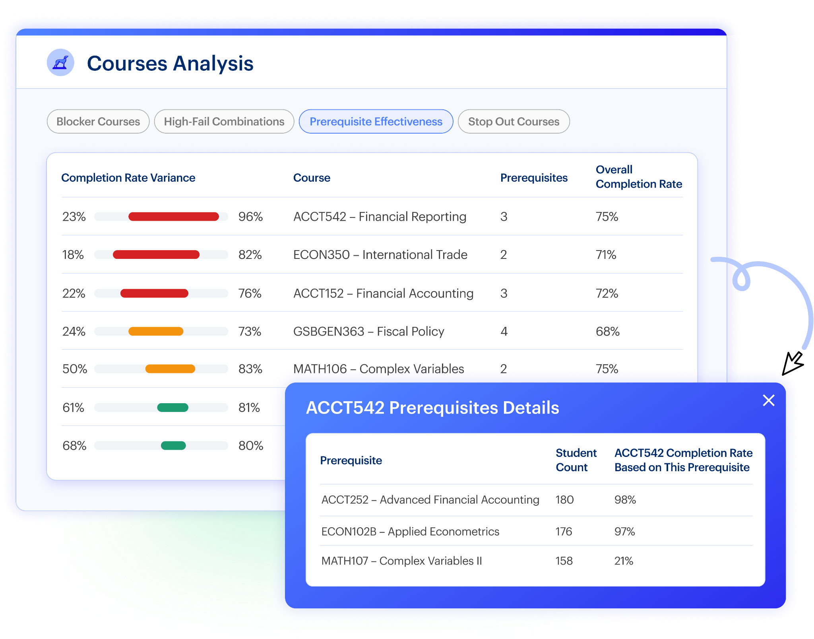
Removing Barriers to Course Completion: Example

Slide 23
Driving Curricular Change With Assessment
Harnessing Analytics to Drive Student-Centric Operations

Slide 24
Assessment to Drive Data-Informed Curricular Change
01
Understand Where Students Need Support
Analyze student success across learning outcomes to see where outcomes are being met and not met. Understand which outcomes are successful to inform how improvement can be made.
02
Identify Gaps in Curriculum Design
Visualize the progression of learning outcomes across programs’ degree requirements. Ensure that the skills and knowledge taught continue to build off each other to enable success after program completion.

Slide 25
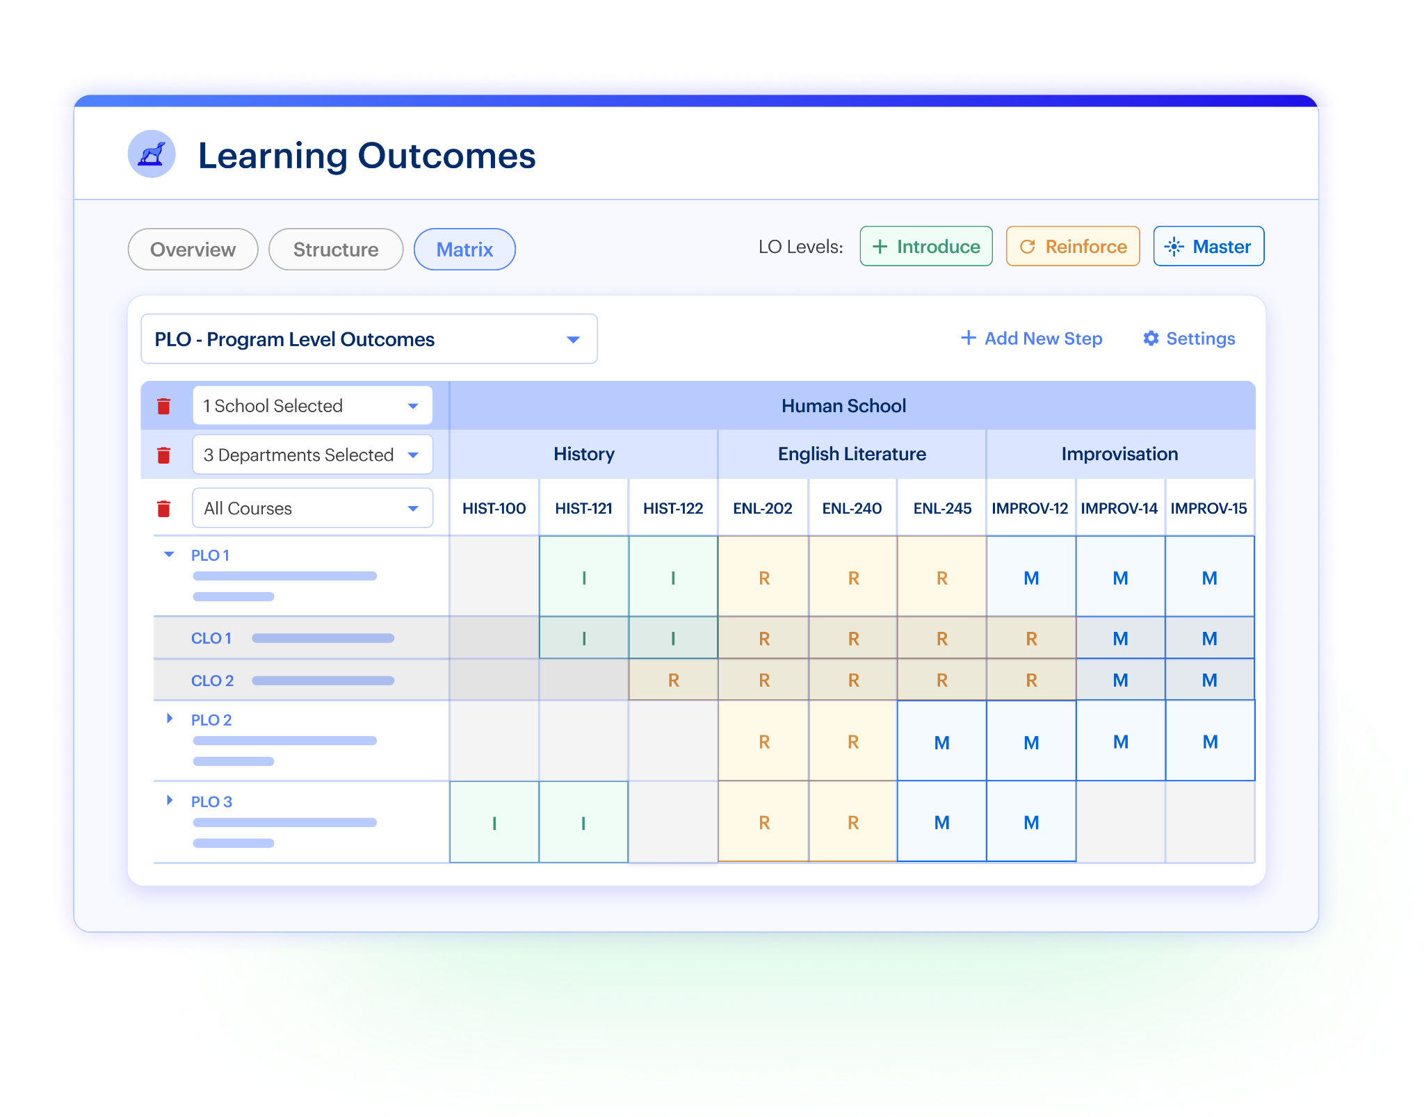
Identify Gaps in Curriculum Design: Example

Slide 26









Our 500+ Partners See Immediate Results
Institutions leverage Coursedog to optimize resources & bolster student success.
90%
+ 54%
60%
Reduction in Time to Complete Curriculum Management
Increase in Balanced Sections Per Semester
Reduction in Course Conflicts Per Semester
Pratt Institute
Hawaii Pacific University
Northern Arizona University

Slide 27
Three Things to Take Home
Academic operations touches every desk in this room. Registration friction shows up as a cost to financial aid, a gap in the schedule or a stalled proposal on someone’s desk.
The friction can be alleviated with data you already have - most of it is stilling in your systems today.
You don’t need to wait. Start with one lever: course demand, program credit ratio, and build from there

Slide 28


Coursedog AI Roadmap
Q2 2026
Q3 2026
Q4 2026
Intelligent Reporting
Monitor and analyze real-time, day-to-day operational data with flexible reporting that goes beyond static dashboards.
Advanced Workflows
Design drag-and-drop workflows to automate processes with rules, actions, and approvals across products.
Ask Cassie & AI Agents
Ask questions about your data and get instant answers without exports, external tools, or manual analysis.

Slide 29
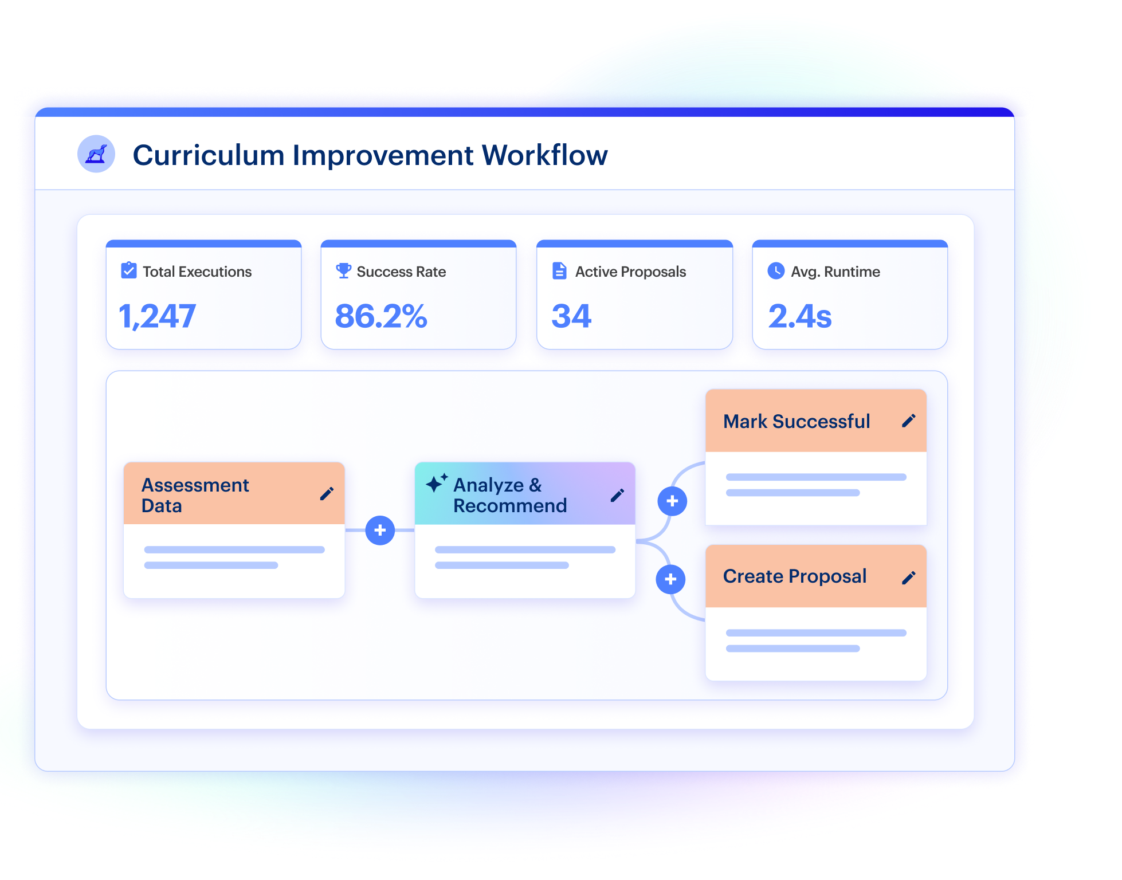
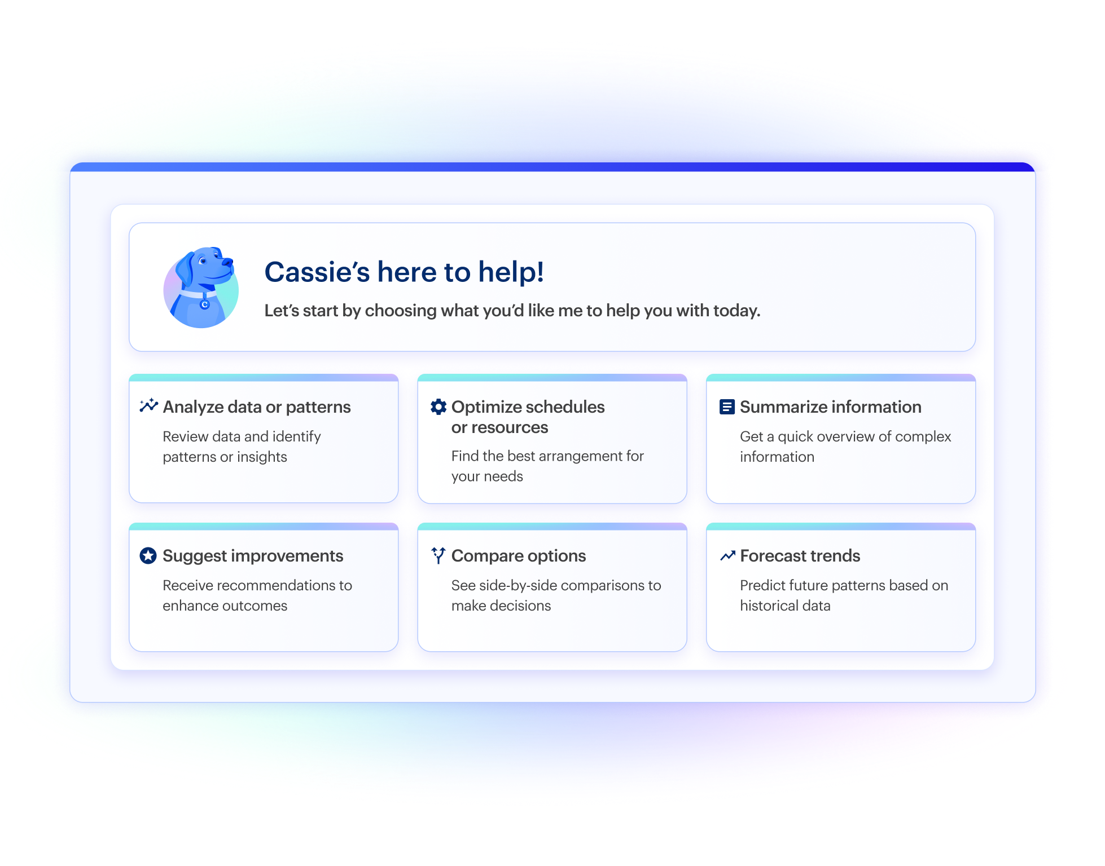
Automate Processes With Agents & Workflows
COMING SOON
NEW
Advanced Workflows: Design drag-and-drop workflows to automate processes with rules, actions, and approvals across products.
AI Agents: Use agents to execute defined tasks, such as creating assessment plans or enforcing policy requirements.

Slide 31
Name
email@coursedog.com

